Slide 1

Structure and Bonding of Diamond, Graphite and Fullerene
Brianna Bonds, Arohee Kumar, Alex Gale, Tucker Wilson and Kwan Jie Lee
Lake Washington Institute of Technology, Kirkland, WA 98034
Mentor: Narayani Choudhury

Slide 2
The design of quantum computers using Nitrogen vacancies in diamond has renewed interest in providing a microscopic understanding of the properties of the various allotropes of carbon.
Here we visualized the crystal structure and electron densities of diamond, graphite, and fullerene to understand the novel structures and bonding in these materials.
Using vector calculus-based methods, we computed the bond lengths and bond angles of diamond, graphite, and fullerene.
We used Xtaldraw, VESTA and Matlab to create the images in this presentation.

Slide 3
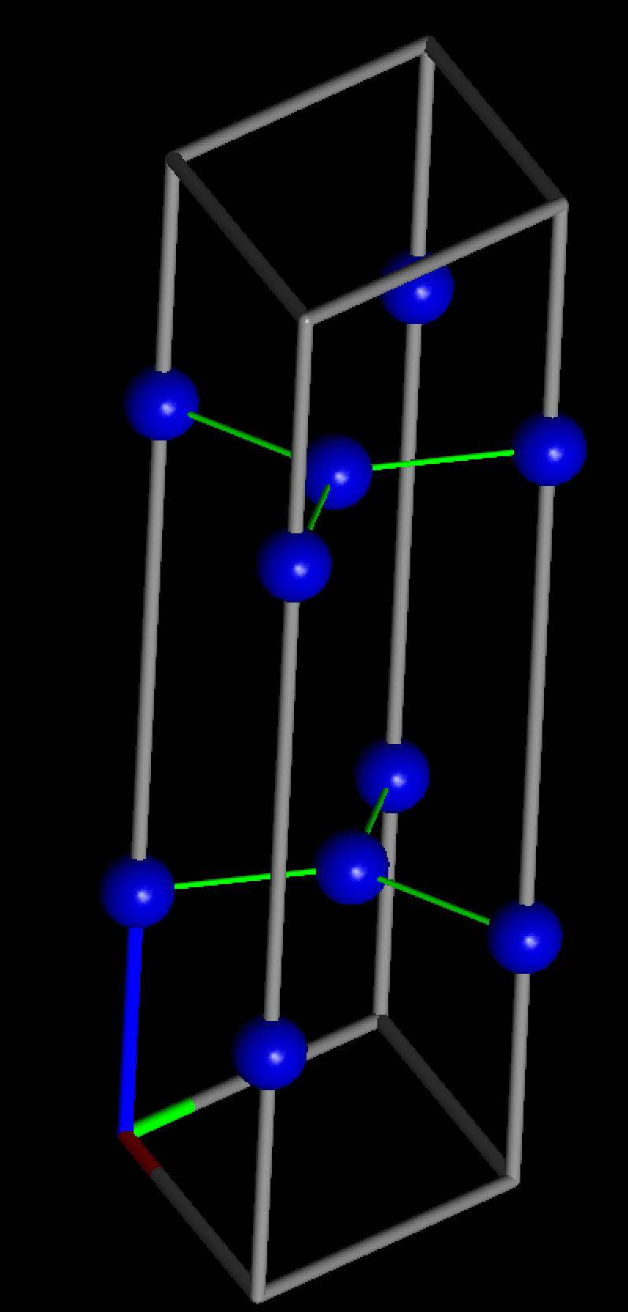
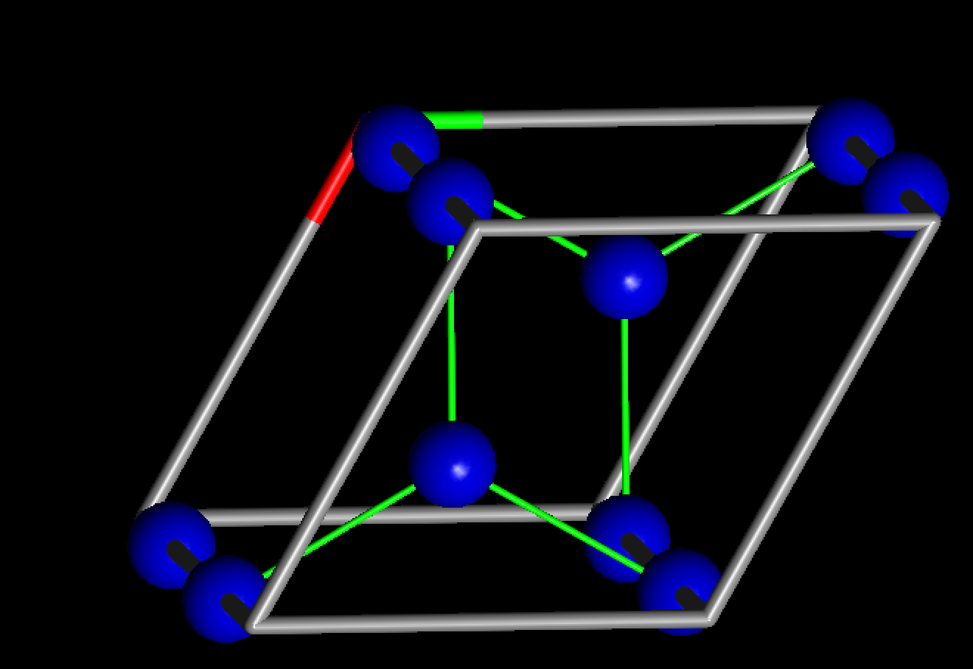
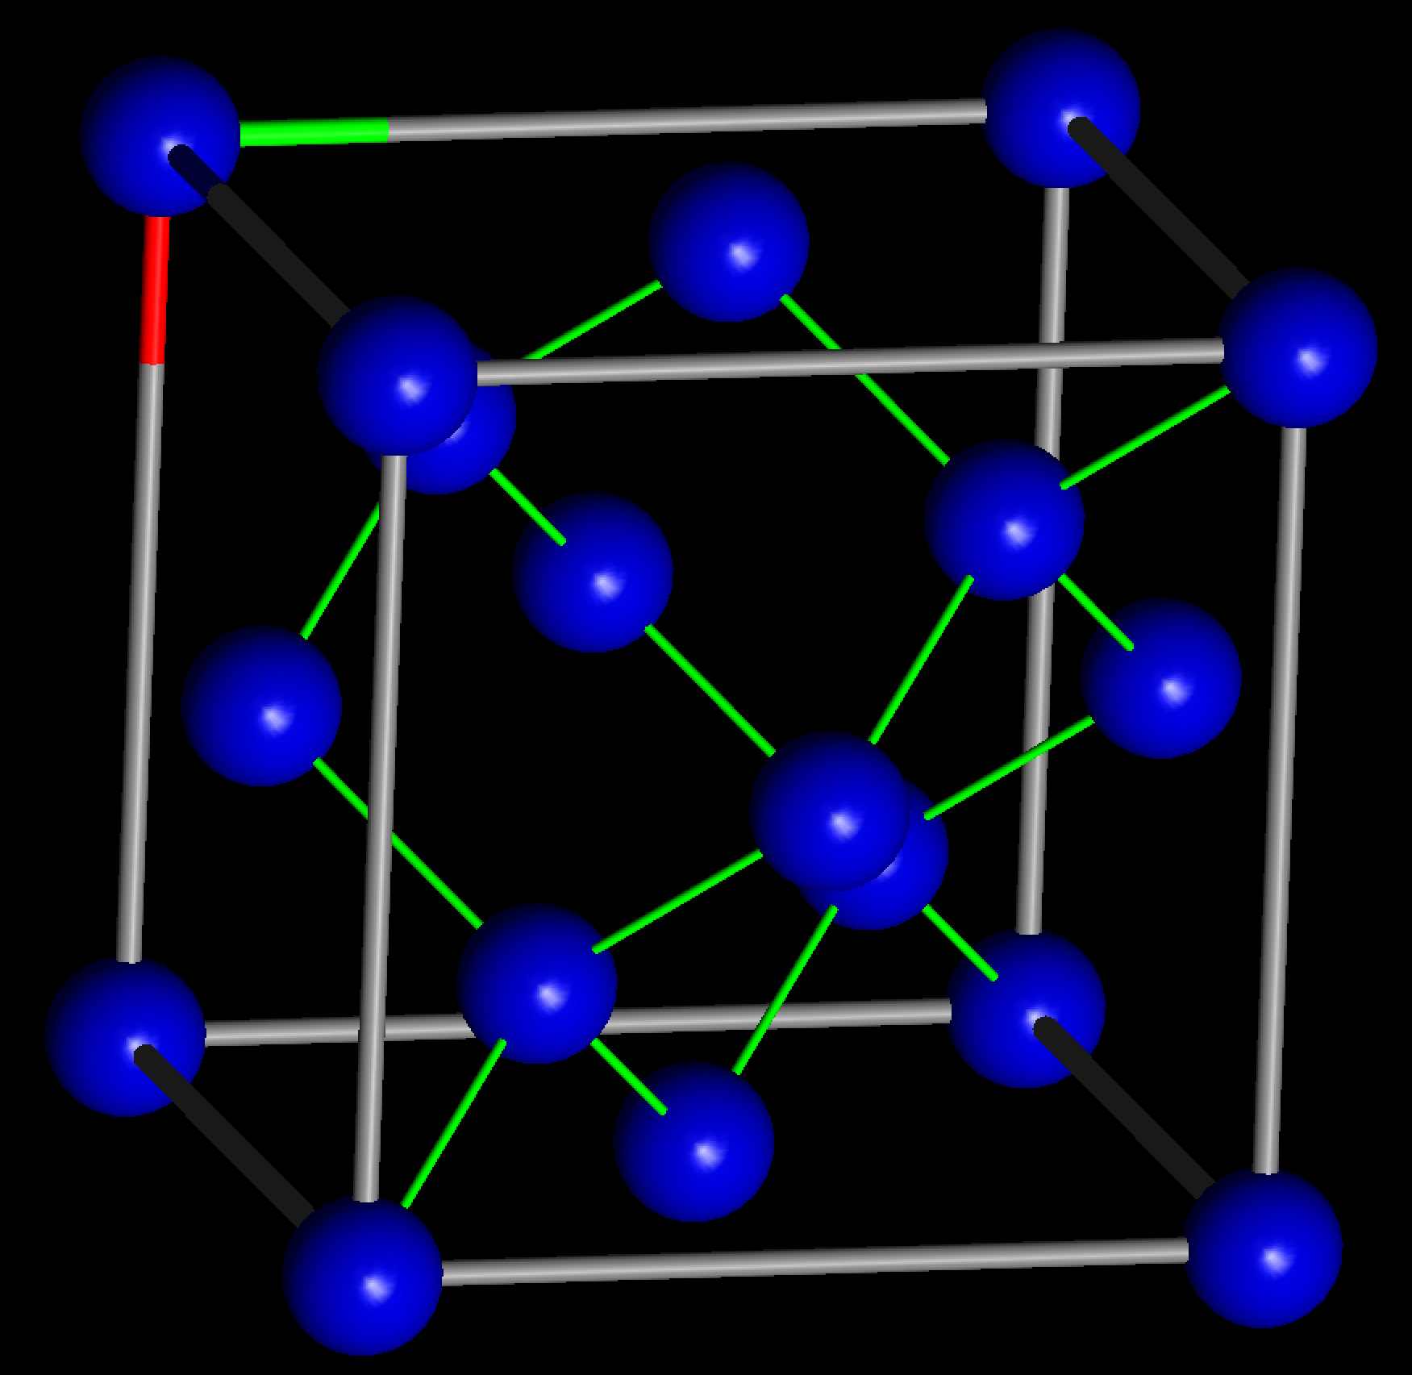
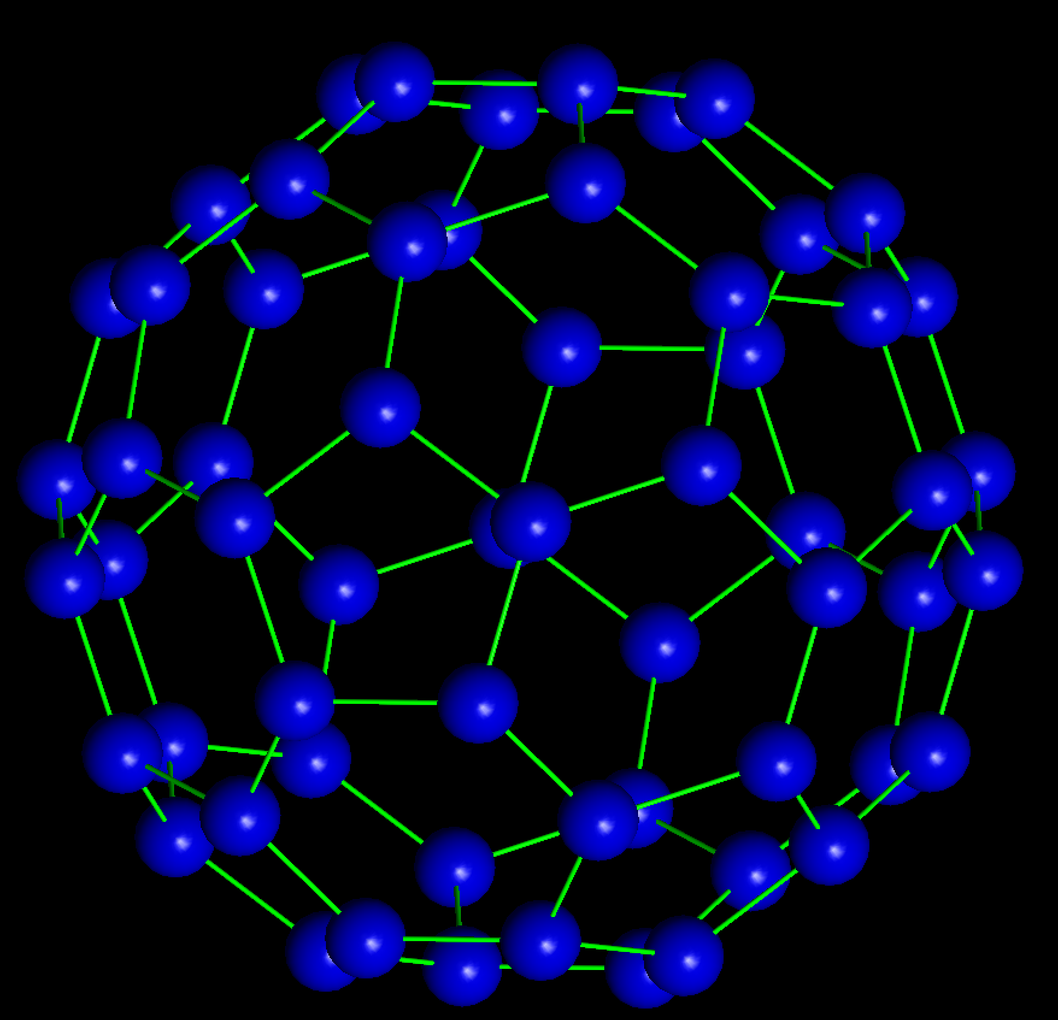
Graphite:
Crystal Structures of Diamond, Graphite, and Fullerene
Crystals: Atoms in a periodic arrangement infinitely repeating in 3-D
Structures characterized by lattice constants a, b, c and α, β, γ
- Differences Between the Allotropes -
Diamond:
Fullerene:
Diamond: Cubic crystal structure; a=b=c;
α, β, γ = 90°
Graphite: Hexagonal crystal a=b ≠c; α=β=90° while γ = 120°
Fullerene C₆₀: Large spheroidal molecule
Drawn using Xtaldraw

Slide 4
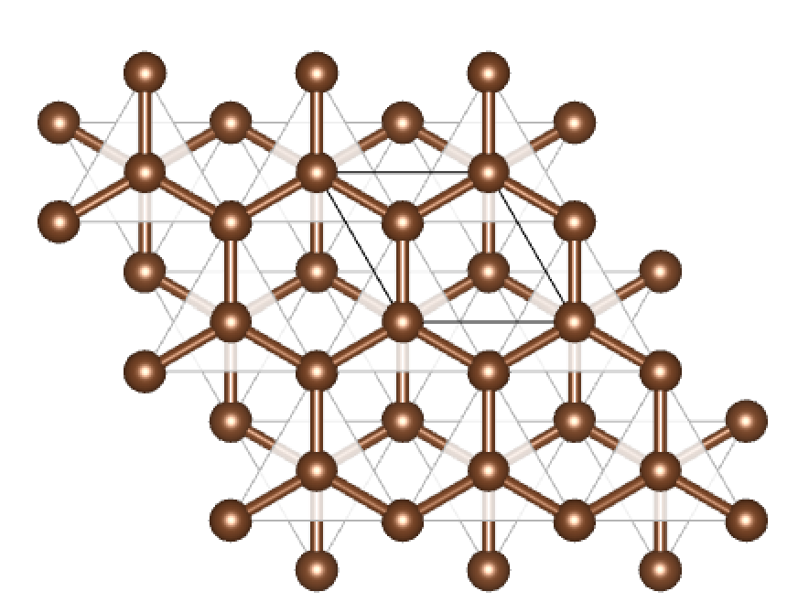
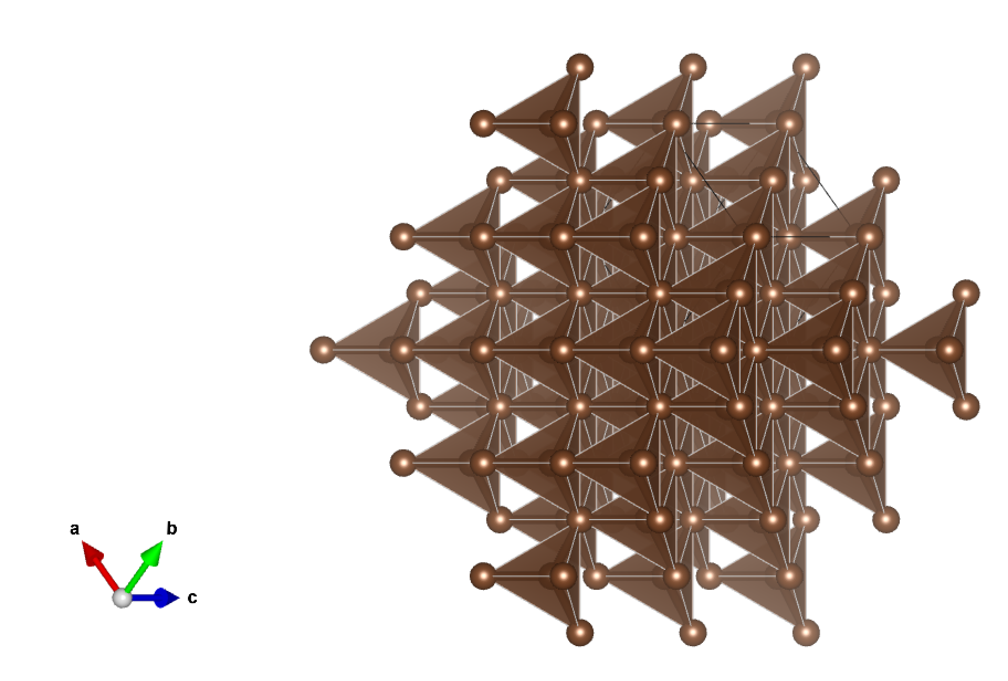
Structure and Properties
Graphite
Diamond
Joined to three other carbon atoms with covalent bonds
Hexagonal arrangement with weak force due to one delocalized electron
Can conduct electricity and be used as a lubricant
Joined to four other carbon atoms with covalent bonds
Regular lattice arrangement with no extra electrons
Physically hard and useful as a cutting tool.
Tetrahedral arrangement of carbon atoms
* While diamond exhibits sp³ bonding, both graphite and fullerene revealed sp² bonding.
* These key changes in structure and bonding gave rise to important differences in their brightness, hardness, electrical conductivity, etc.
Drawn using Xtaldraw and VESTA codes

Slide 5
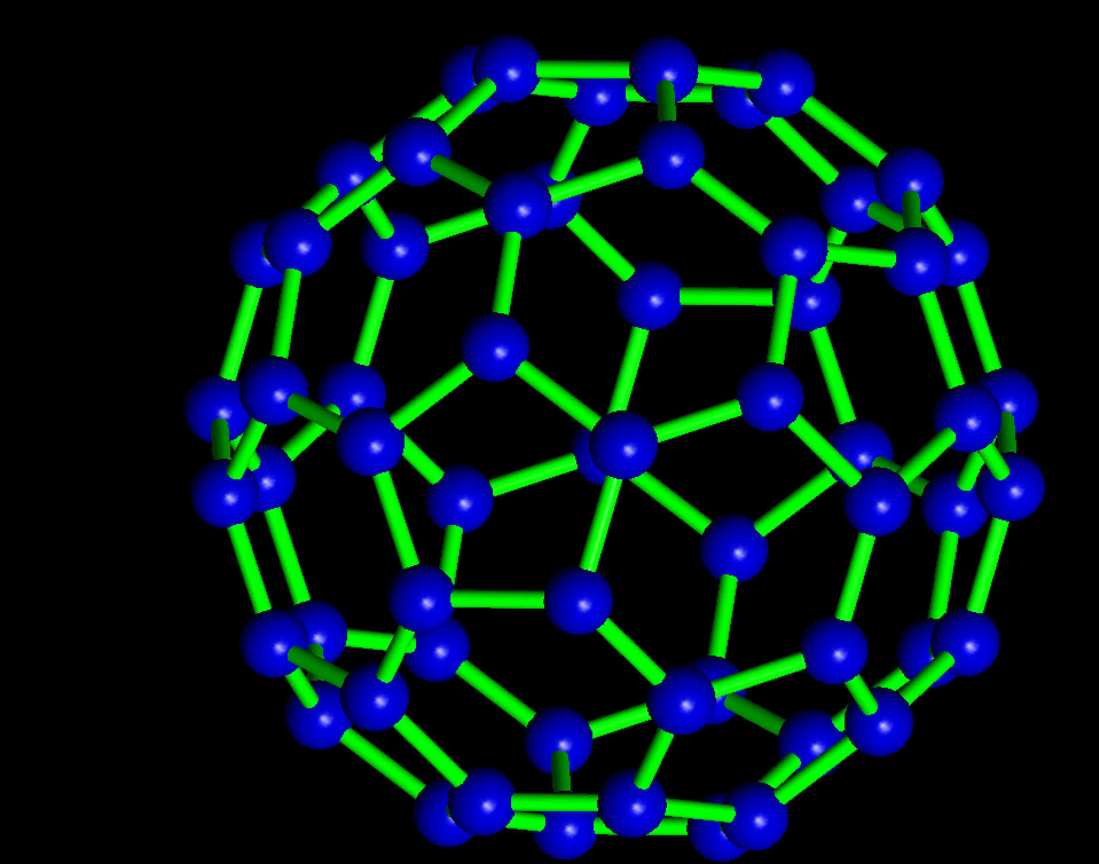
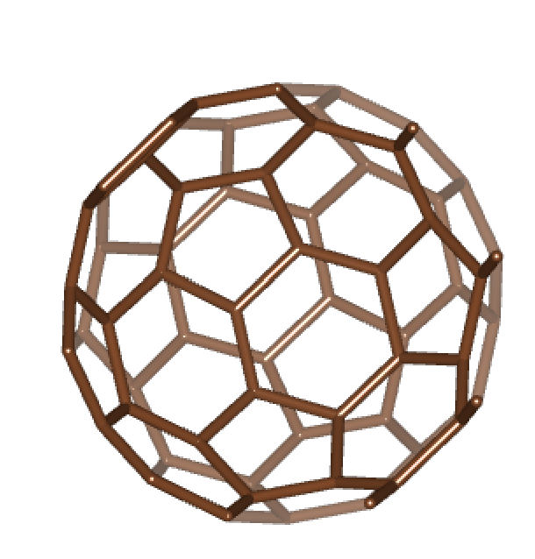
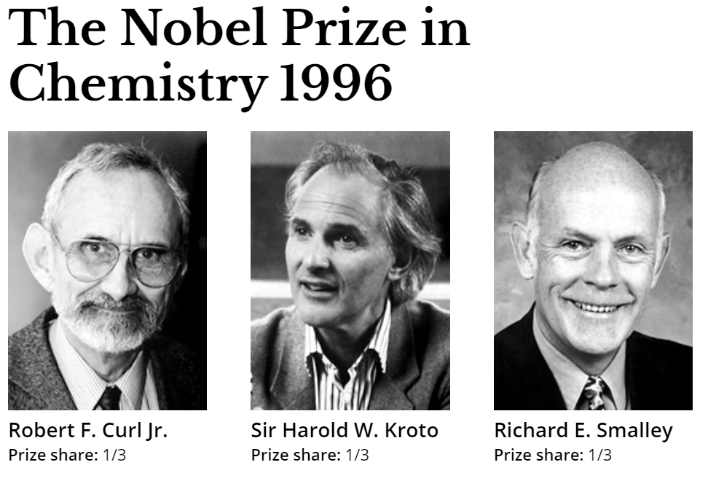
Fullerene
Carbon vapor condensed into stable clusters of C₆₀ and are identified as giant molecules.
Have been found in interstellar dust
Polymer Fullerene composites is used as photovoltaics in solar panels
For the Discovery of Fullerenes
Drawn using Xtaldraw and VESTA codes

Slide 6
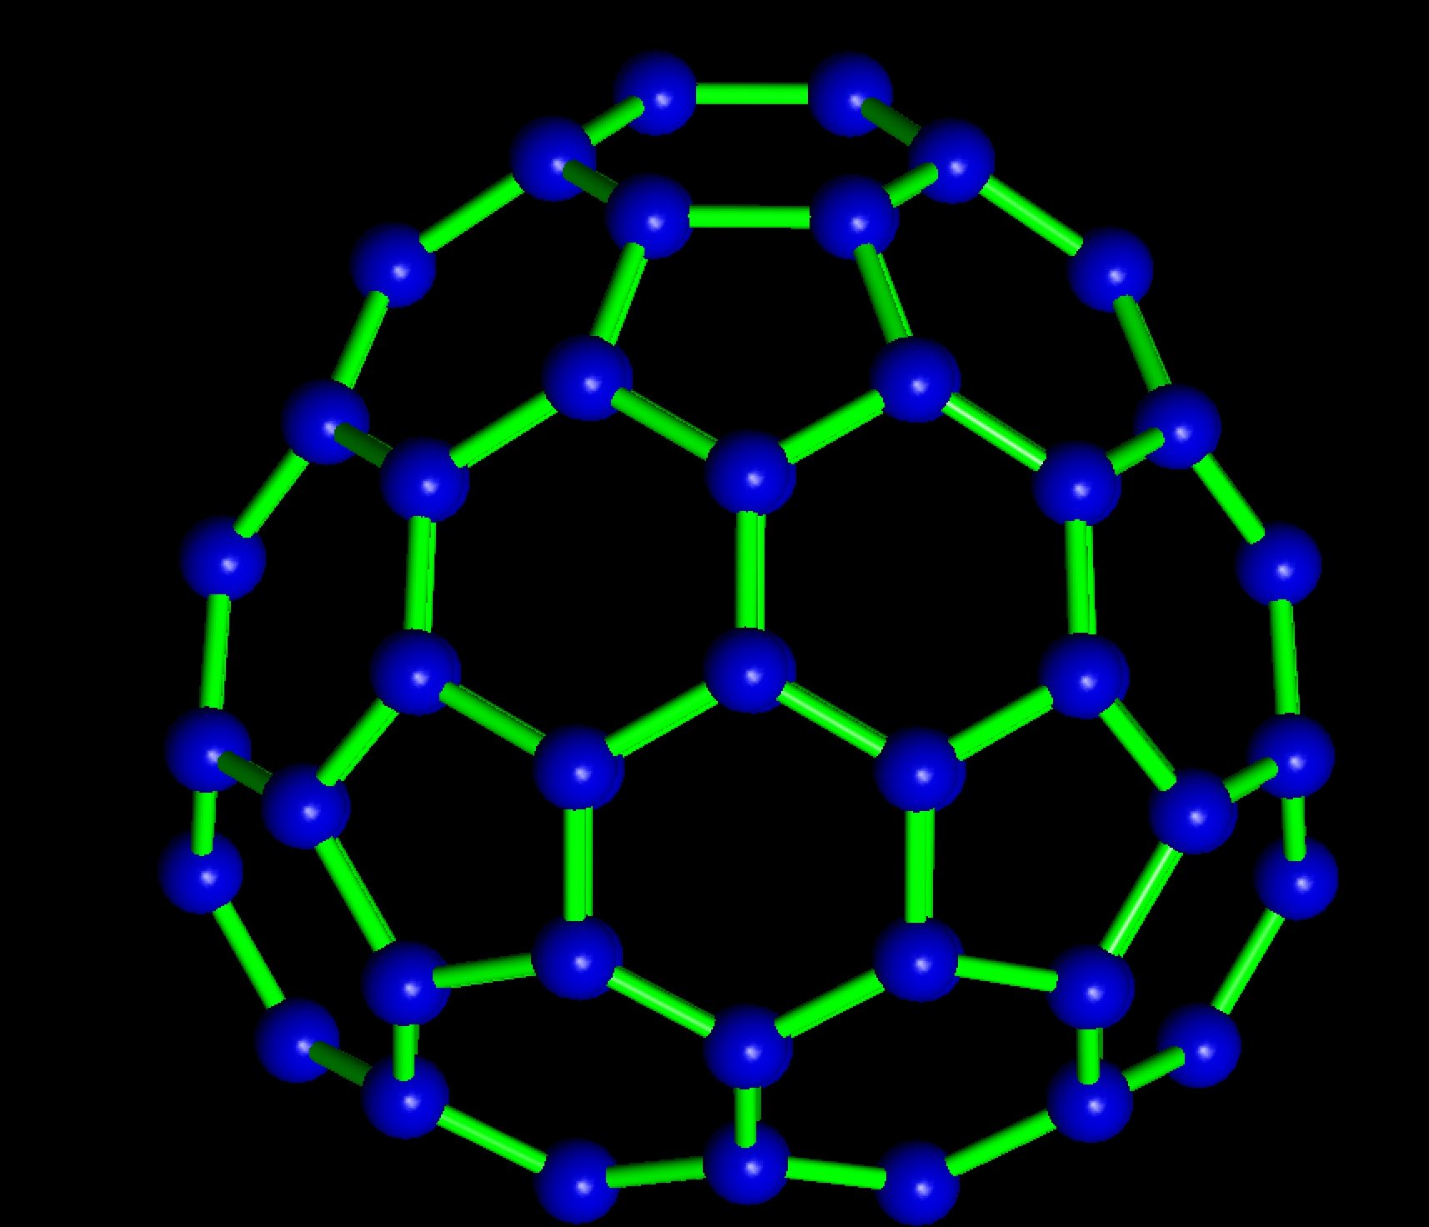
There are several fullerene variants
C₆₀, C₇₀, C₇₄.
All of them have exactly 12 pentagons due to Euler’s rule
Whereas C₆₀ is highly symmetric; C₇₄ shows significant asymmetry
Drawn using Xtaldraw

Slide 7
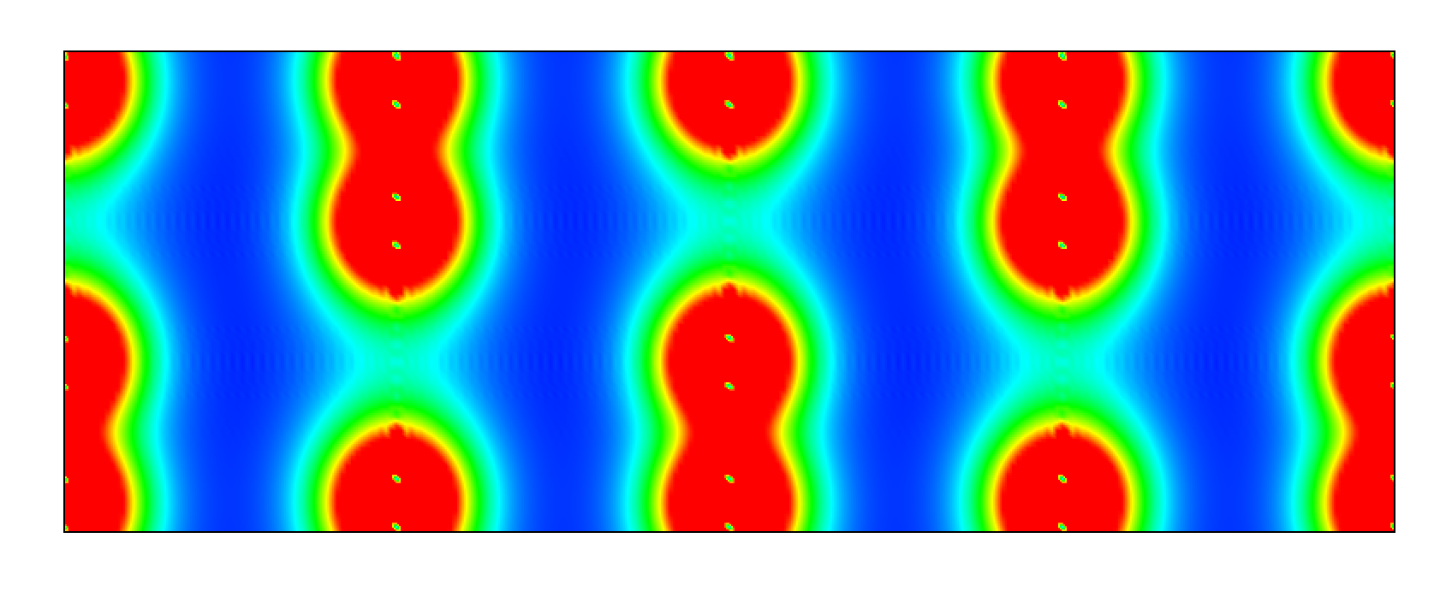
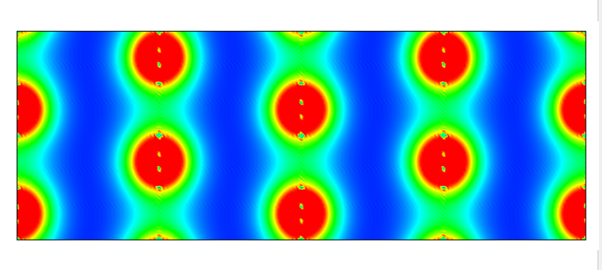
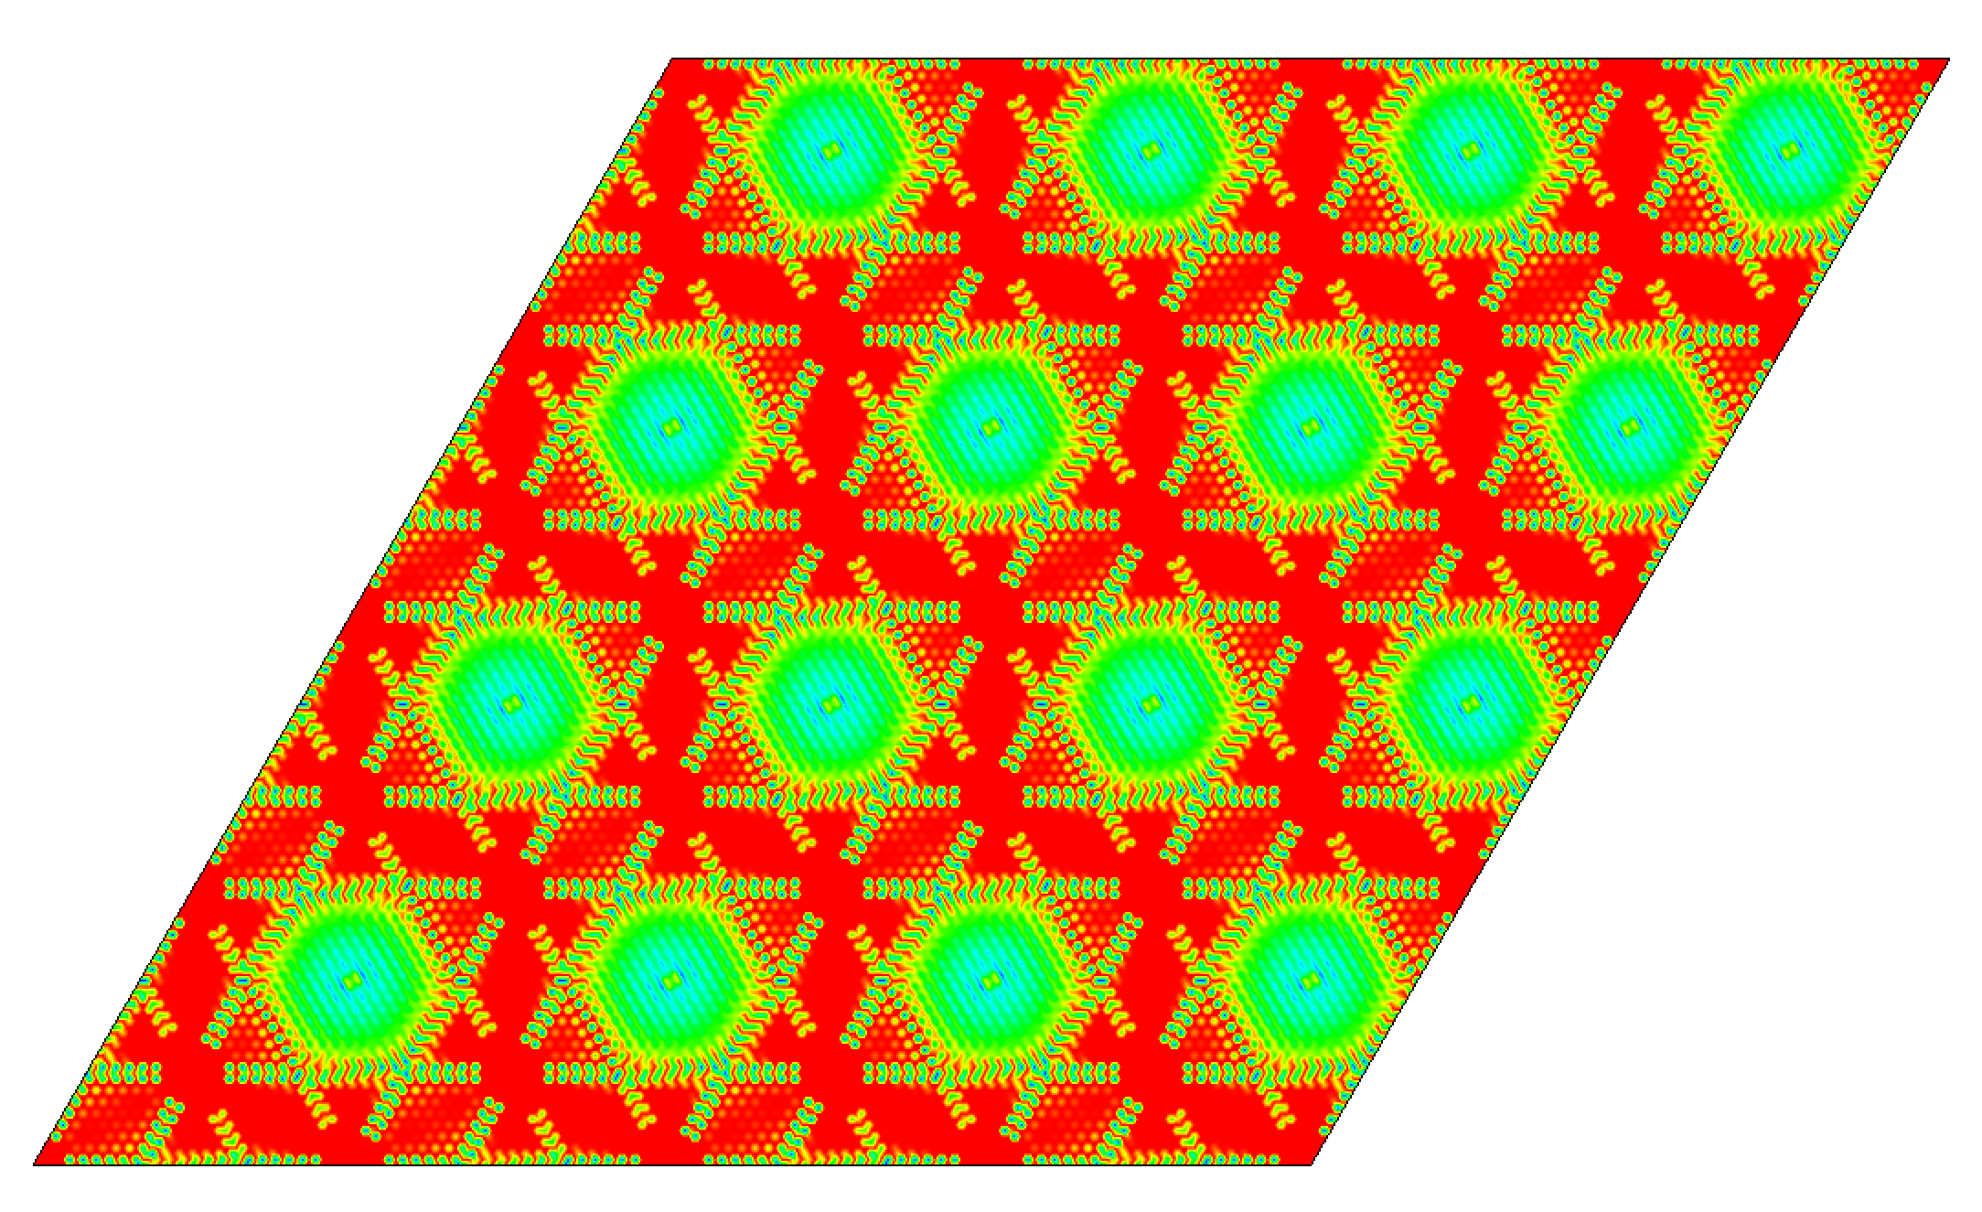
Crystal Structures and Electron Densities of Graphite
Hexagonal structures indicate carbon having trigonal planar geometry
Trigonal planar geometry --> sp² hybridization with sp² orbitals
These sp² orbitals can be seen pointing to the vertices of the structure
Electron densities show trigonal planar format of atoms in Graphite's ab-plane
Sigma and pi bonds shown in the ab-plane
Without hydrogen, strong C-C covalent network forms
C=C double bonds and delocalization
Van der Waal forces seen in out-of-plane bonding
Drawn using Xtaldraw and VESTA codes

Slide 8
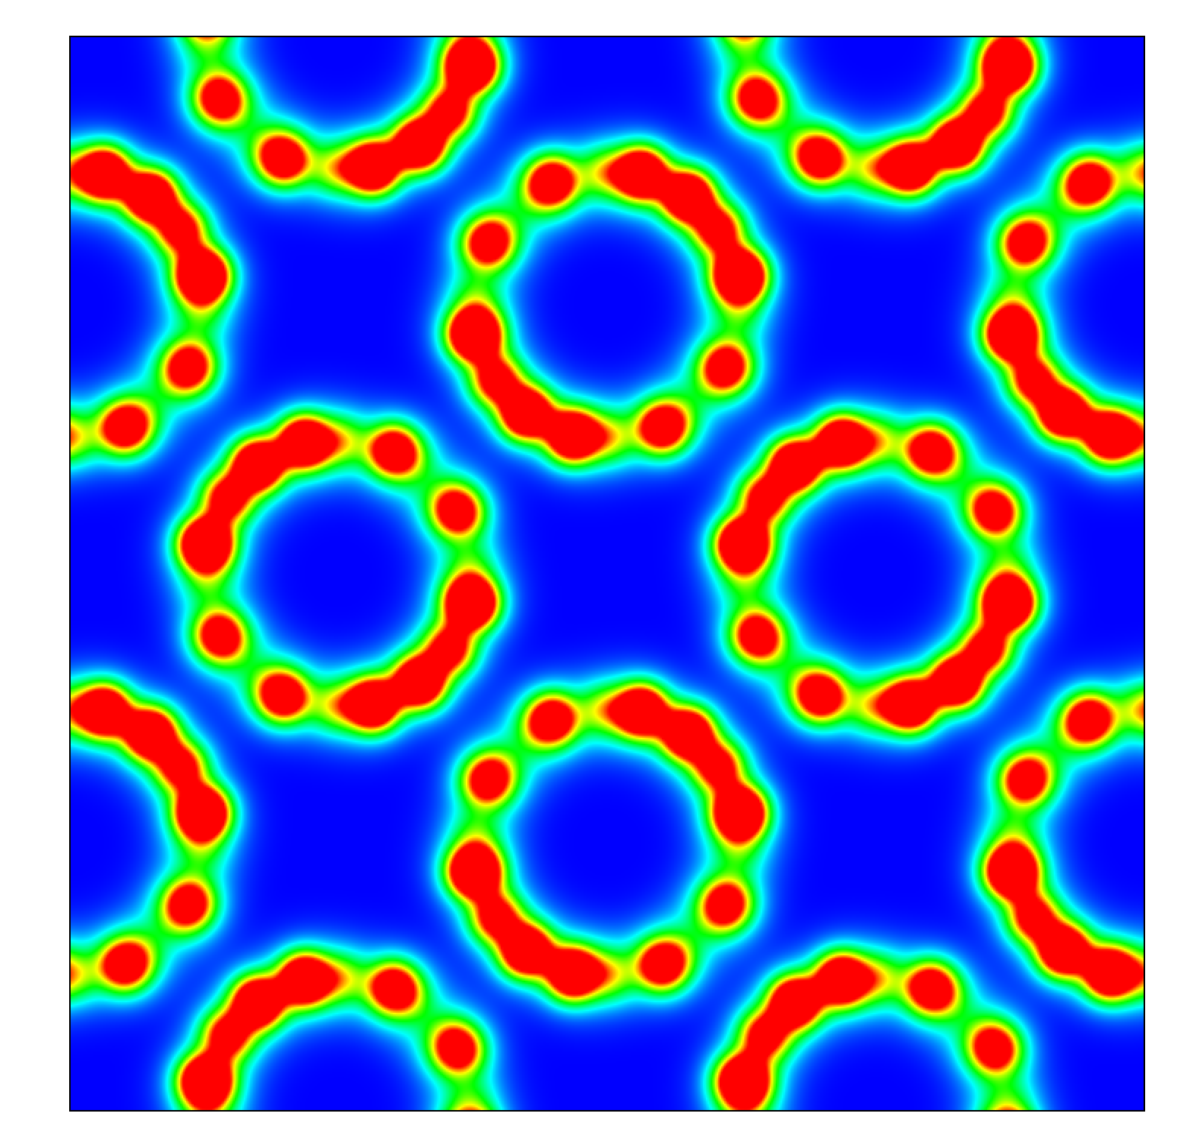
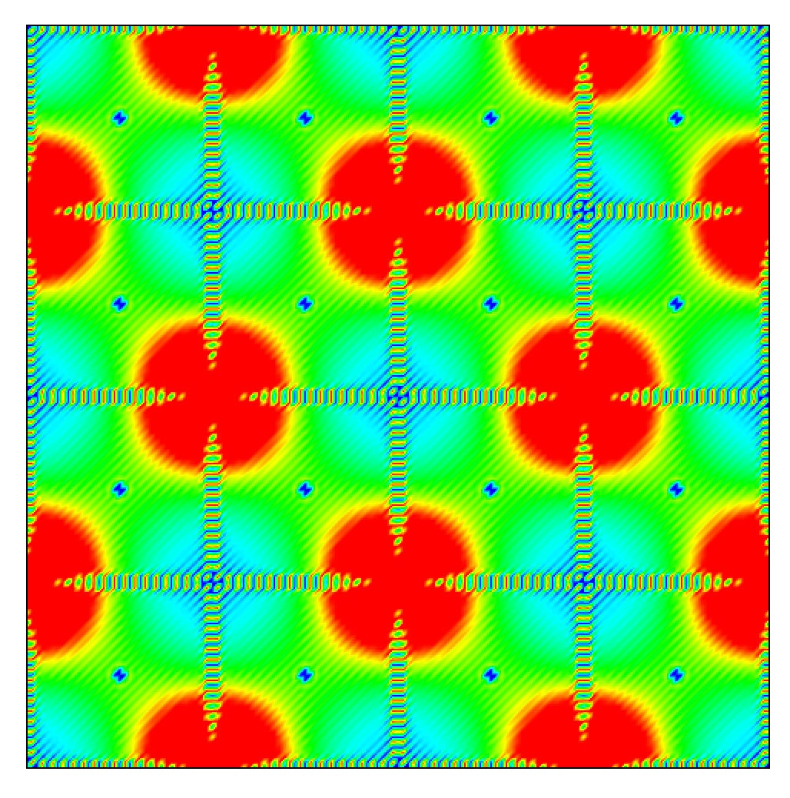
Electron Densities of Diamond and Fullerene
Double bonds: hexagon-hexagon
Single bonds: hexagon-pentagon
Bonding creates alternating bond ring network
Electron density of fullerene indicates sp² hybridization
Diamond has tetrahedral orientation seen with sp³ bonding
Drawn using Xtaldraw and VESTA codes

Slide 9
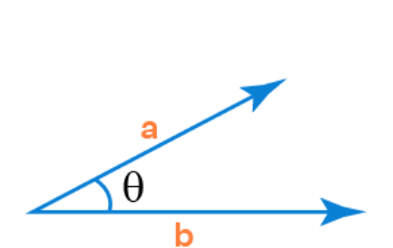
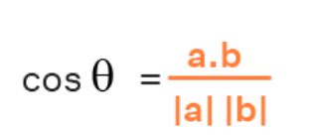
We use Vector Calculus to calculate bond length and angles
We converted Fractional coordinates to Cartesian coordinates and used the distance formula to calculate the nearest neighbor and next nearest neighbor bond lengths
We used vector dot products to calculate the bond angles.

Slide 10
Diamond
Graphite
C₆₀
Drawn using Xtaldraw
1 Å = 10⁻¹⁰ m

Slide 11
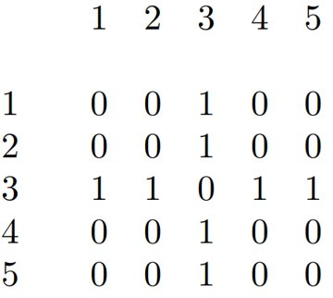
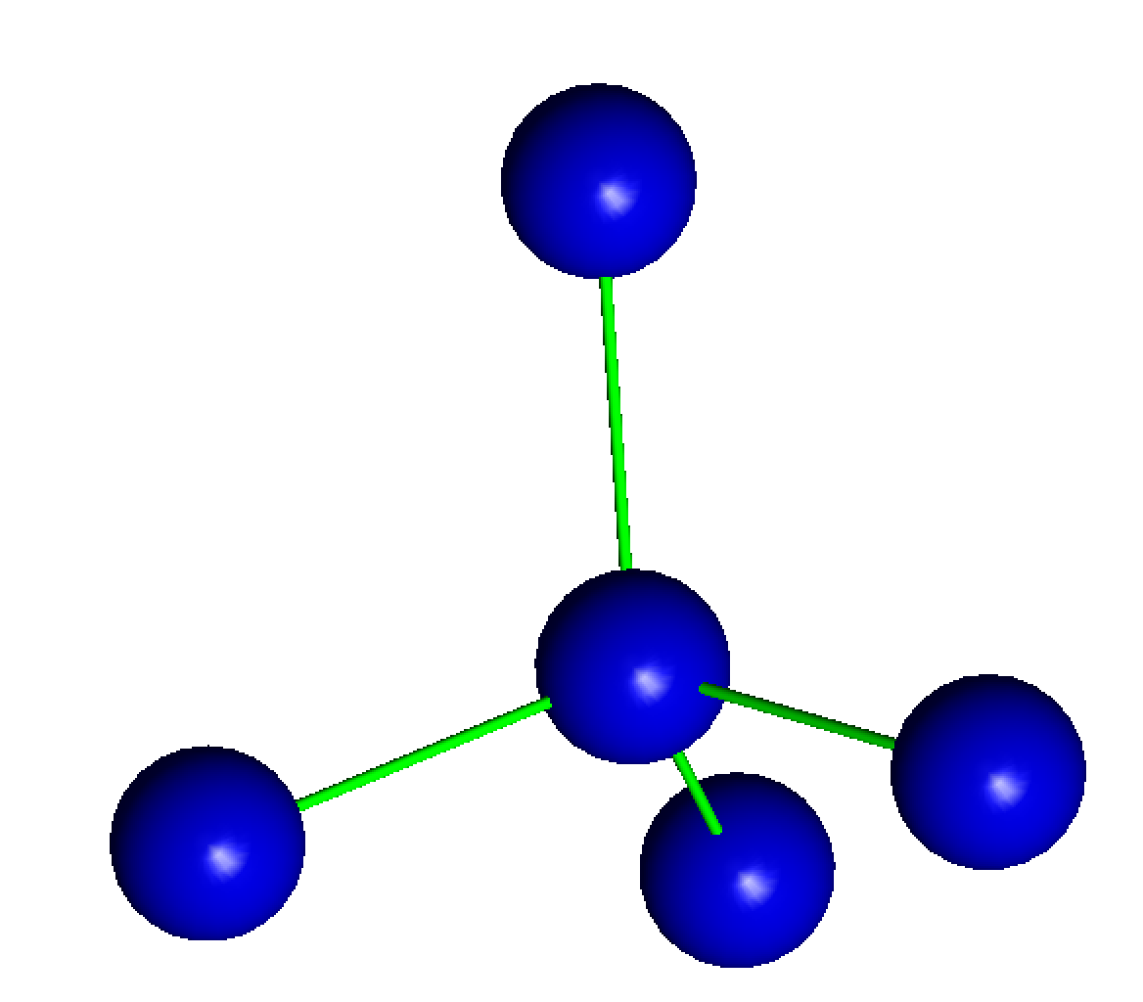
Using graph theory to write adjacency matrix to study network connectivity of undirected graphs
a_{ij}= number of paths that link nodes i and j
1
3
2
5
4

Slide 12
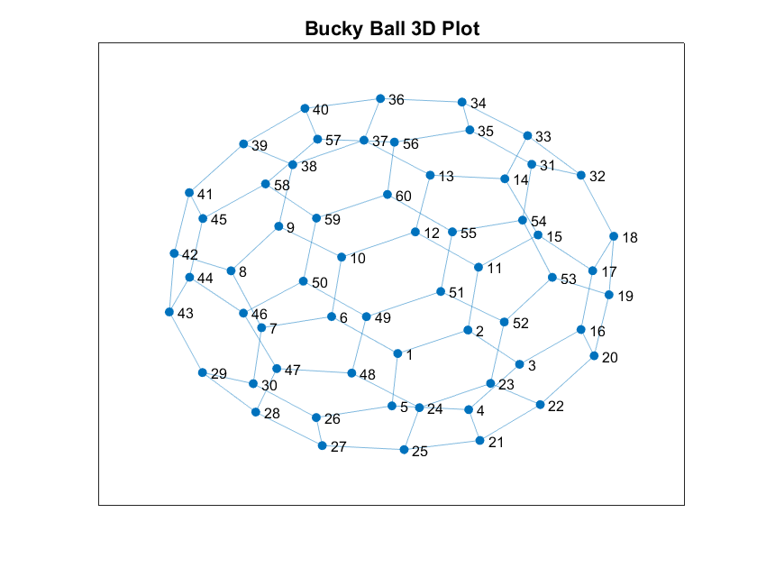
Using Matlab, one can label the Carbon atoms and use that to create the adjacency matrix that can be used to study the network connectivity in fullerene

Slide 13
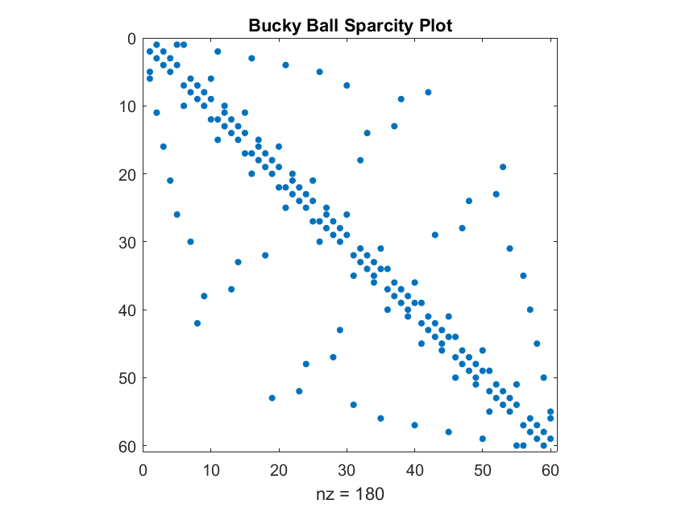
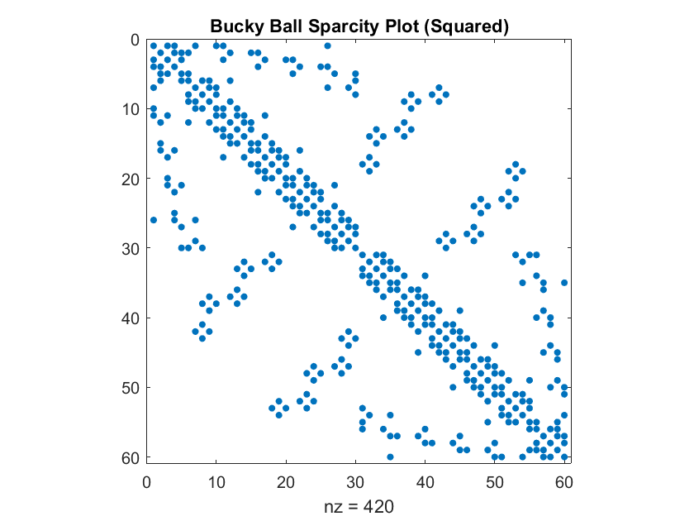
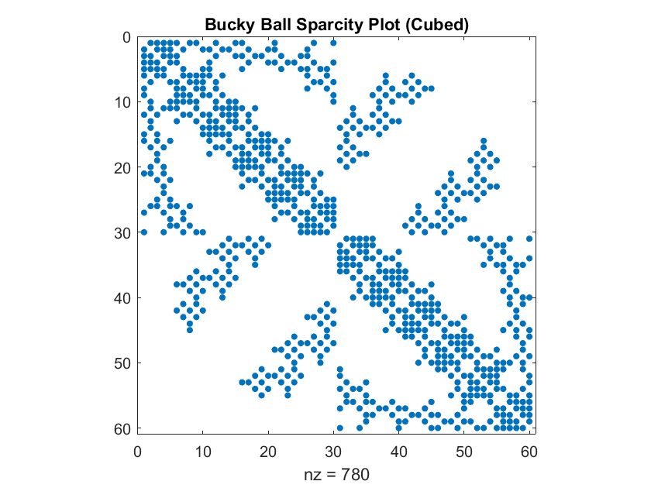
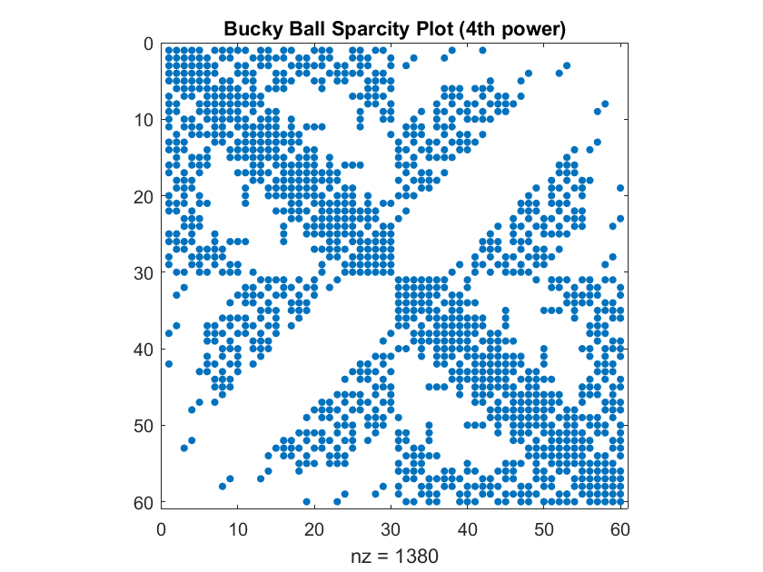
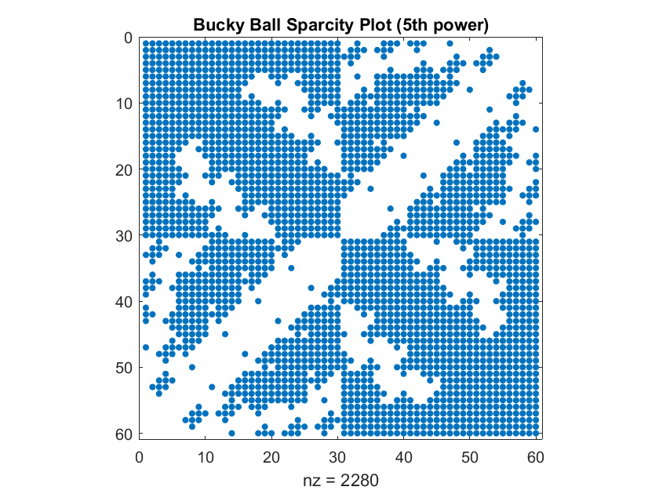
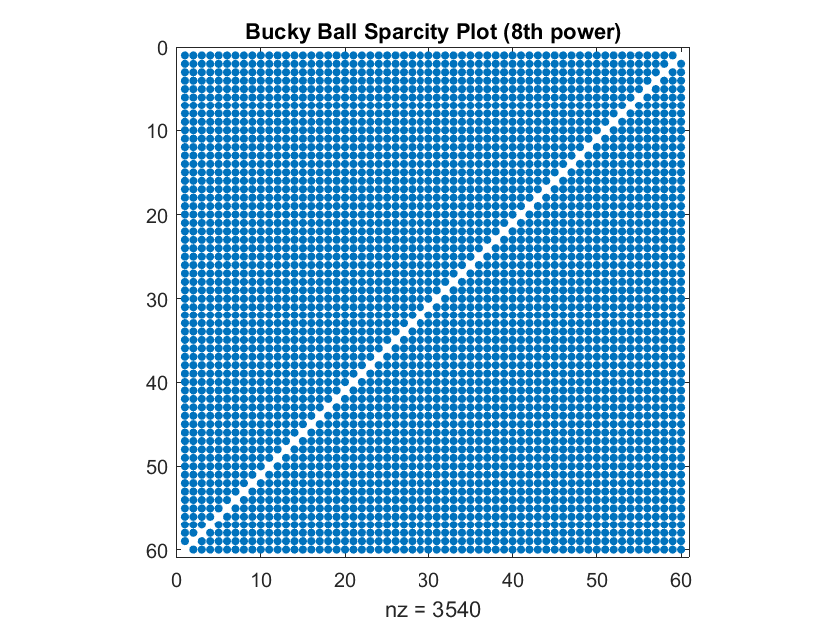
Matlab’s spyplot has been used to display the adjacency matrix in fullerene. Each carbon atom in C₆₀ (blue) is connected by bonds to three carbon atoms.
The adjacency matrix of fullerene is a sparse matrix with more zeros (white background), than 1 (blue dots in the graph) and was sketched using matlab using spyplot to graph it.
This matrix displays the connectivity network of the icosahedral spheroidal molecular fullerene having the structure shown above.

Slide 14
Conclusions
These studies provide a microscopic atomic level understanding of the structure, bonding and network connectivity of these materials.
Key changes in structure and bonding give rise to important differences in the properties of Diamond and graphite.
The adjacency matrix of fullerene helps understand Carbon network connectivity in Fullerene.
The project provides excellent opportunities for data visualization and exploration.
The quantum properties of diamond arise from its novel structure and bonding and these studies provide an atomic level understanding of the structures in these materials.

Slide 15
References
Xtaldraw
https://www.geo.arizona.edu/xtal/group/software.htm
VESTA
https://jp-minerals.org/vesta/en/
Matlab
https://www.mathworks.com/products/matlab.html
Diamond- Quantum Computers
https://physicsworld.com/a/the-diamond-quantum%E2%80%AFrevolution/#
https://www.bbc.co.uk/bitesize/guides/zgq8b82/revision/2
https://chem.libretexts.org/Bookshelves/General_Chemistry/Book%3A_ChemPRIME_(Moore_et_al.)/08%3A_Properties_of_Organic_Compounds/8.21%3A_Diamond_and_Graphite

