Slide 1

Mathematical modeling for computer vision
Christian Tarta, Nicholas Develle, Han Ji, Kwan Jie Lee and Alex Gale
Mentor: Narayani Choudhury
Lake Washington Institute of Technology, Kirkland, WA 98033

Slide 2
Introduction
Computer vision is a branch of artificial intelligence
Computer vision involves applications of mathematical methods and computers for machine learning from digital images and videos.
Computer vision finds key applications for process automation
  Optical character recognition (OCR) for automated check clearing
  Digitizing text and image records for online databases
  Automated analysis of surveillance camera videos for security
  Automated reading of text from car license plates in a parking lot
  Machine learning, etc.
Other advanced applications of computer vision
  Design of automated search engine for image search (Google’s next step)
  Object identification for Robotics, Self Driving cars
  Surveillance for cashier free stores like Amazon Go

Slide 3
How can we feed visual information to a computer in a form that it can understand and operate on?
We digitized handwritten character images into arrays and applied transformations to vectorize data for dimensional reduction.
We applied vector and scalar projections of these vectors for optical character recognition.
We applied linear-algebra-based algorithms for OCR and Image Compression
We wrote codes using python scientific libraries for optical character recognition and image compression.

Slide 4
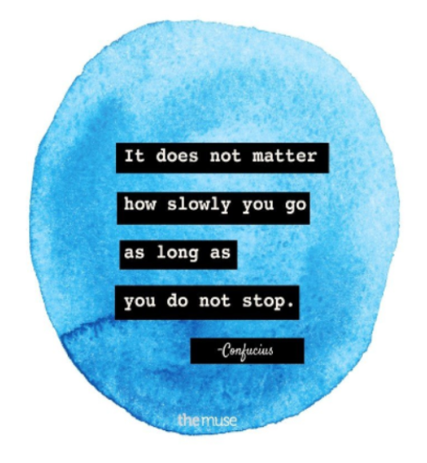
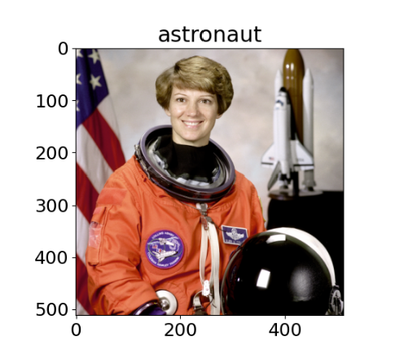
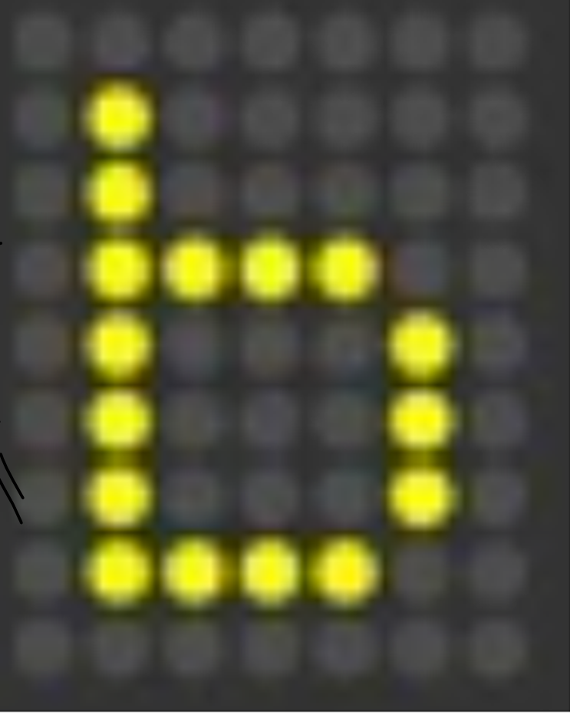
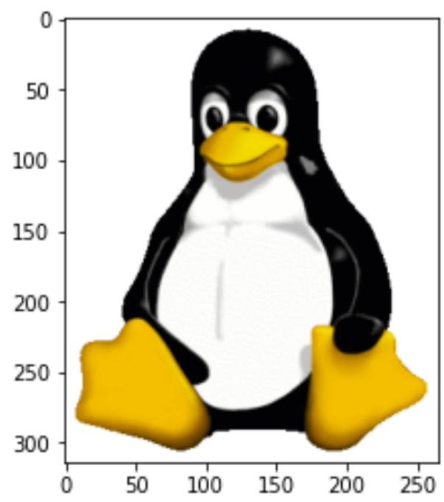
Image Credits
We used the Images below for our Computer Vision studies in this project
https://www.shutterstock.com/image-vector/led-display-font-digital-scoreboard-alphabet-1440128090
Tux Mascot
Larry Ewing, Used GIMP
https://en.wikipedia.org/wiki/Tux_(mascot)
https://www.themuse.com/advice/50-inspirational-career-quotes
https://scikit-image.org/

Slide 5
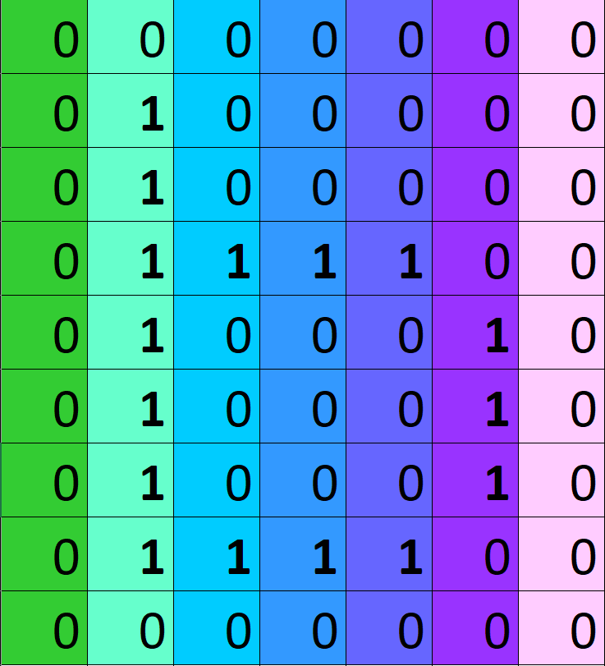
Vector: 1-D
Matrix: 2-D
Tensors: Multi-D
Results and Analysis
Matrix representation
Dimensional
reduction
9 x 7 matrix
9 x 7 light panel
63 x 1 vector

Slide 6
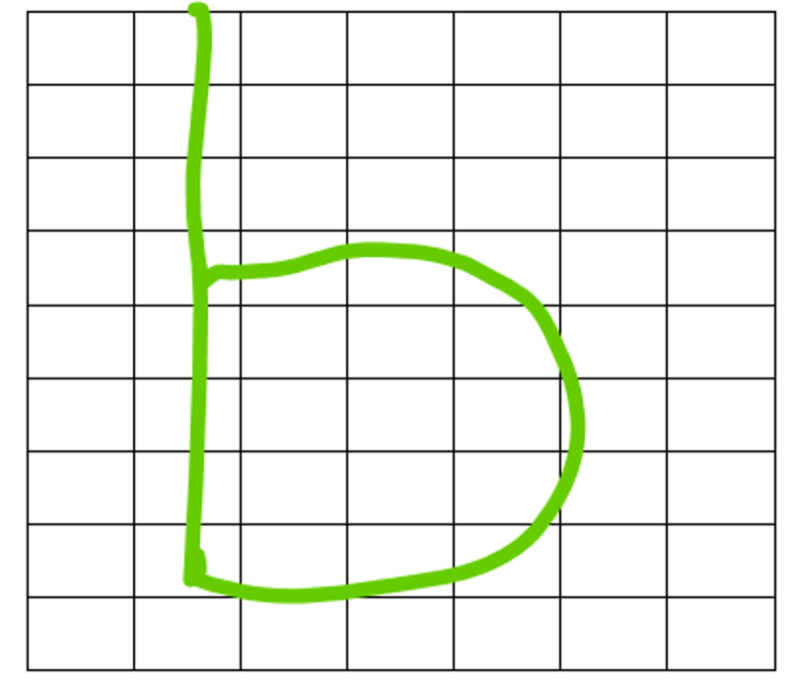
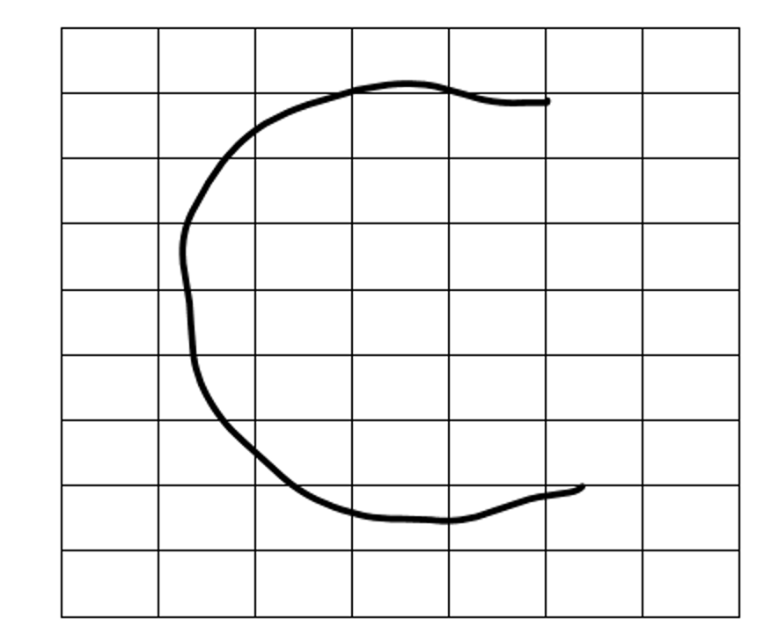
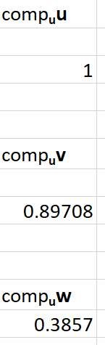
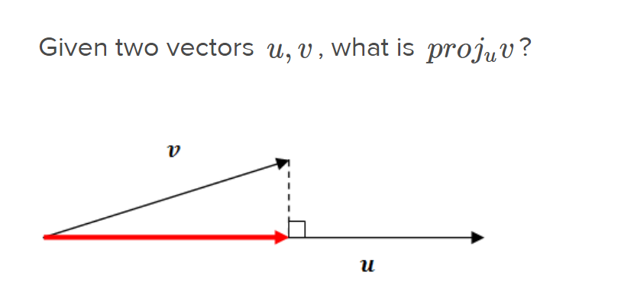
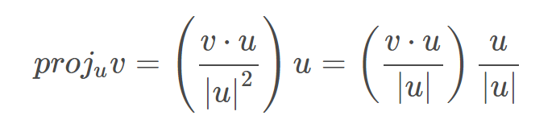
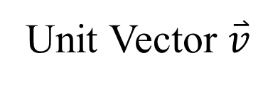
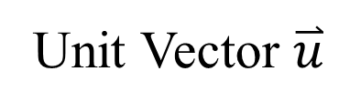
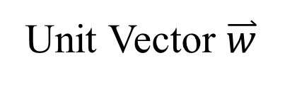
Scalar
Unit Vector $\overset{⃑}{u}$
Unit Vector $\overset{⃑}{v}$
Unit Vector $\overset{⃑}{w}$

Slide 7
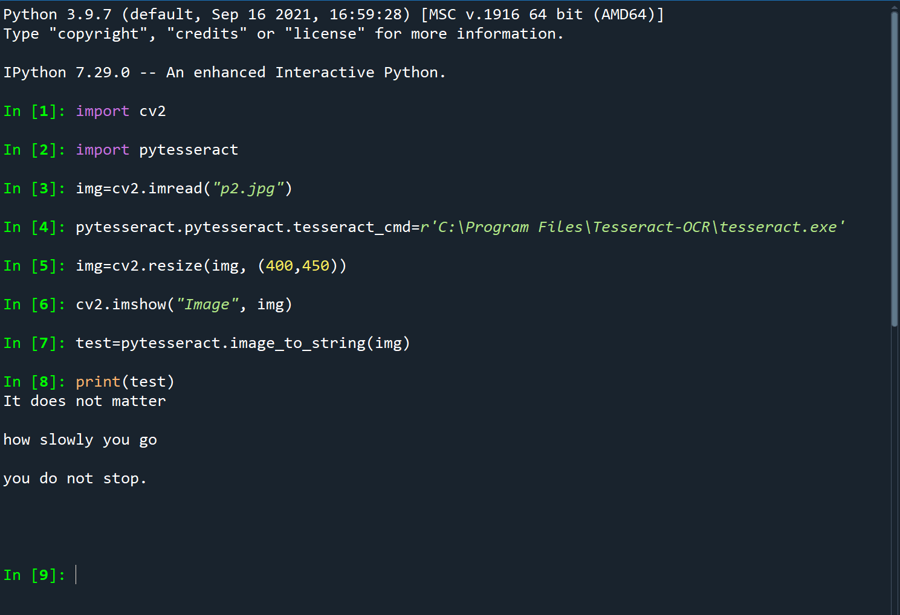
Using Python Tesseract-OCR to read text embedded within image

Slide 8
* We applied algorithms with foundations in linear algebra and wrote programs using Python scientific libraries for optical character recognition and image compression.
* Using IPython and Numpy, we characterized color and grayscale images as arrays and implemented singular value decompositions (SVD) and principal component analysis (PCA) for grayscale and color image compression studies and OCR.

Slide 9
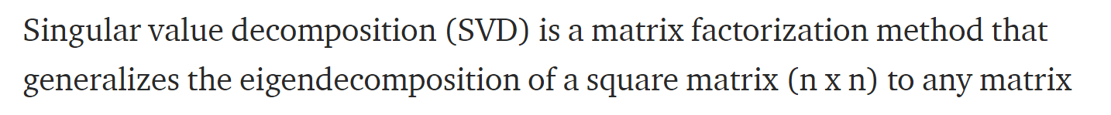
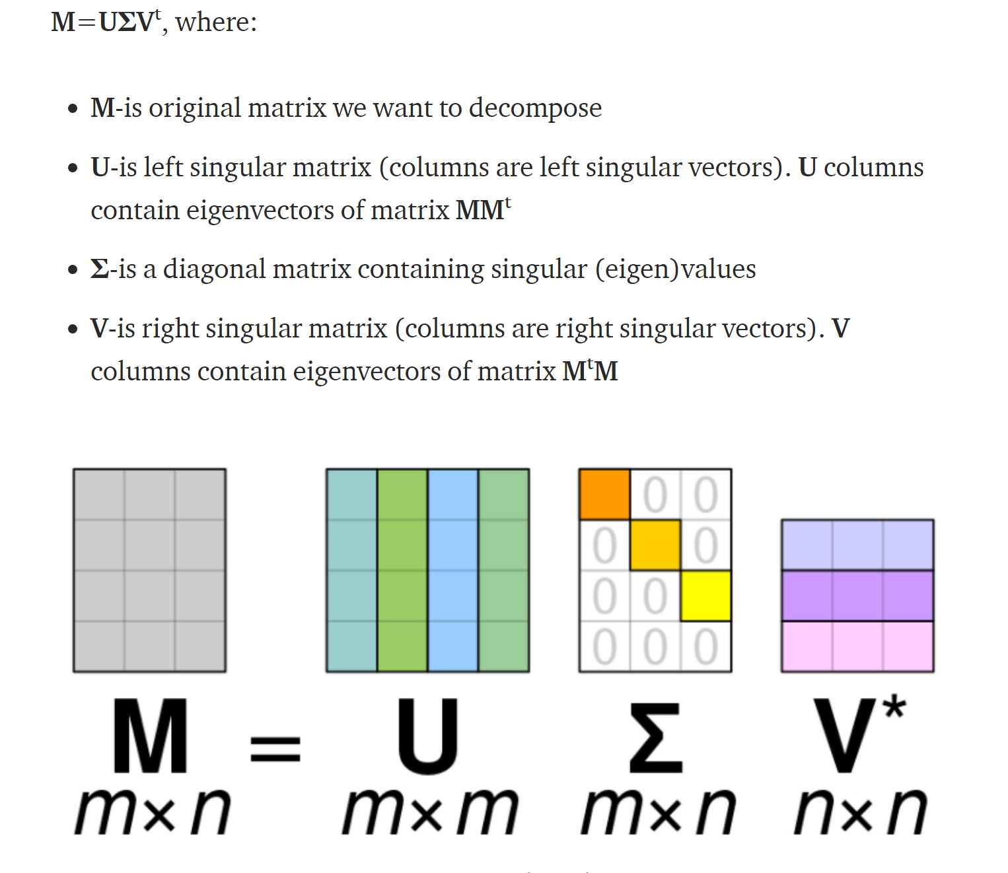
U, V are rotation matrices and are orthogonal
V*=V^{T} = Transpose of V
Σ is diagonal (stretching/compression)

Slide 10
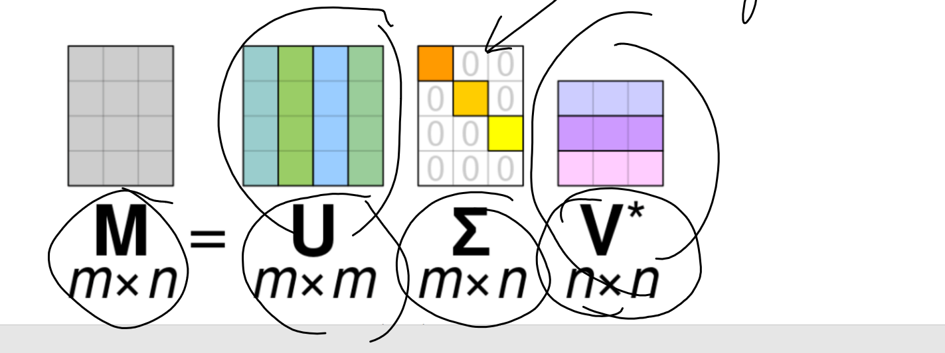
Steps to find SVD of matrix M (mxn)
(i) MM^{T} has dimensions mxm – Calculate eigenvalues and eigenvectors of MM^{T}
The eigenvectors of MM^{T} form columns of U
(ii) S is a diagonal mxn matrix and the diagonal elements of S are square root of the eigenvalues of MM^{T}
(with additional zeros in the diagonal if required for dimensional matching)
(iii) M^{T}M has dimensions nxn - Calculate eigenvalues and eigenvectors of M^{T}M .
The eigenvectors of M^{T}M form columns of V
V*= V^{T}
We used NUMPY/Python to do the Singular Value decomposition

Slide 11
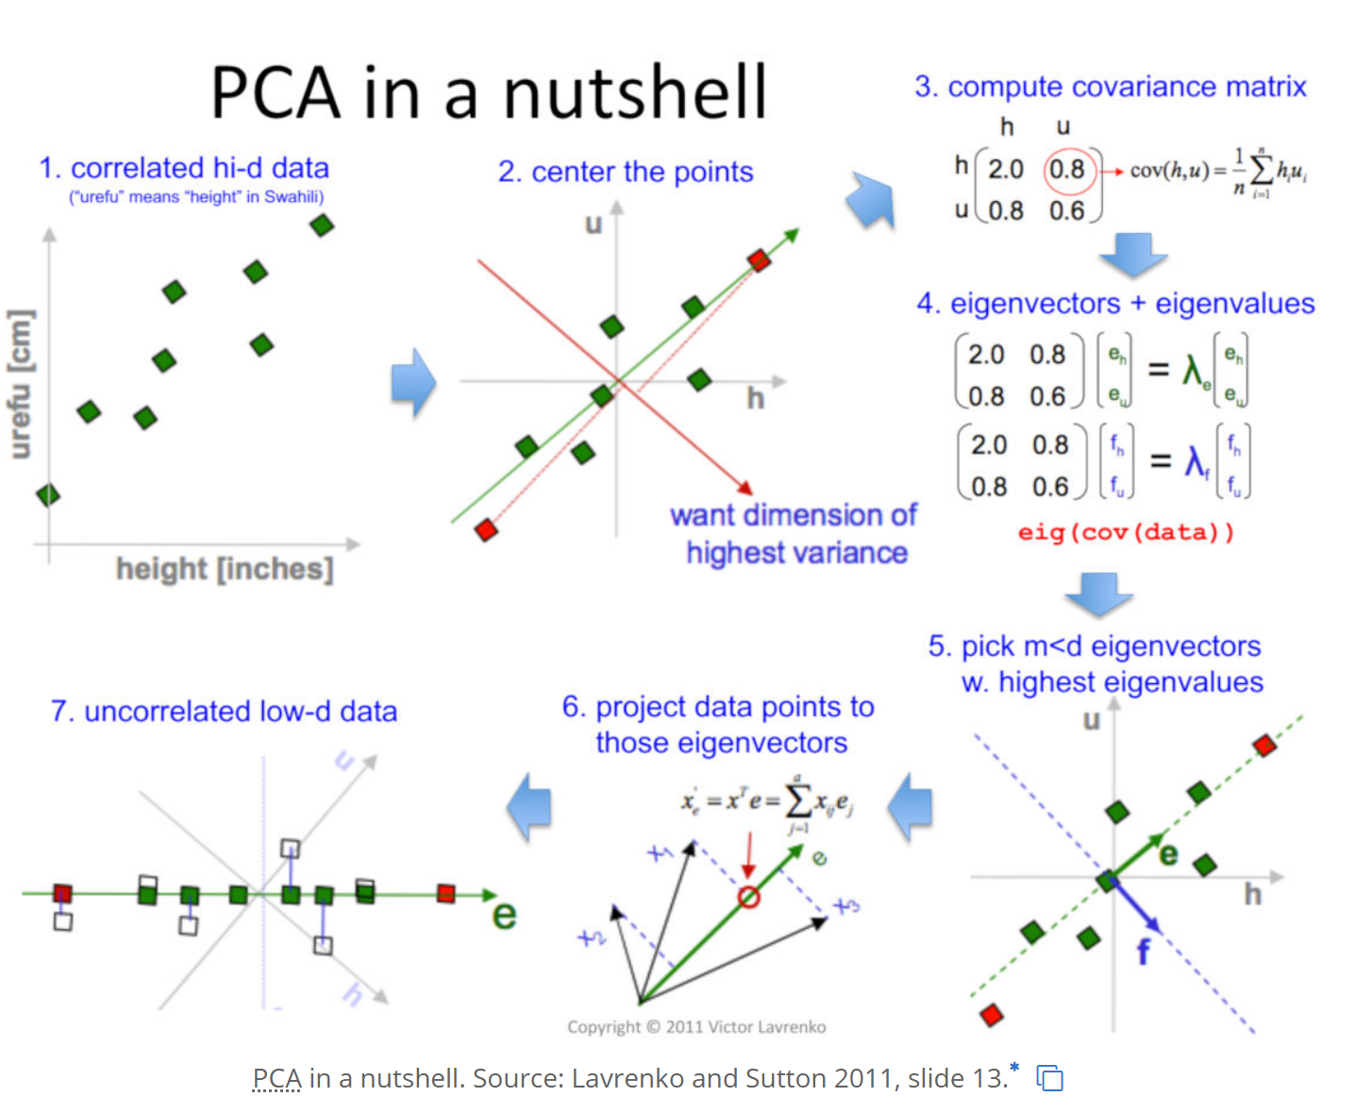
https://devopedia.org/principal-component-analysis

Slide 12
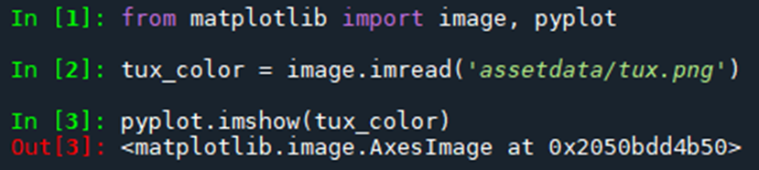
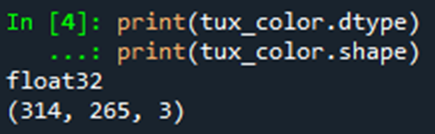
Compression
UΣV^T = X
SVD Approximates X when not all ranks are included
Tux (left) created by Larry Ewing 1996 using GIMP
Convert Image to an array and display it using python's matplotlib.pyplot
Size
https://en.wikipedia.org/wiki/Tux_(mascot)#:~:text=Tux%20is%20a%20penguin%20character,depict%20Tux%20in%20various%20styles
.
Notes:
So, we understand that , and we know that the further we go down the diagonal of sigma values in the sigma matrix the smaller they become, which means that the lower ranks, affected by those values, are less significant in the resultant matrix. Thusly we can approximate much of the image by leaving out a certain last section of ranks in the three matrices. This allows the us to reduce the data size, compressing the image.
To do this we utilized the matplotlib python library and the PIL library, which is very popular for loading images. Here we load the image, with these lines. And you can see by the tux_color.shape property that it is a 3 dimensional array.

Slide 13
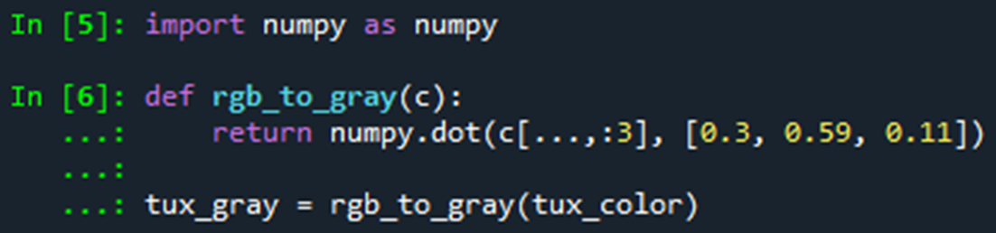
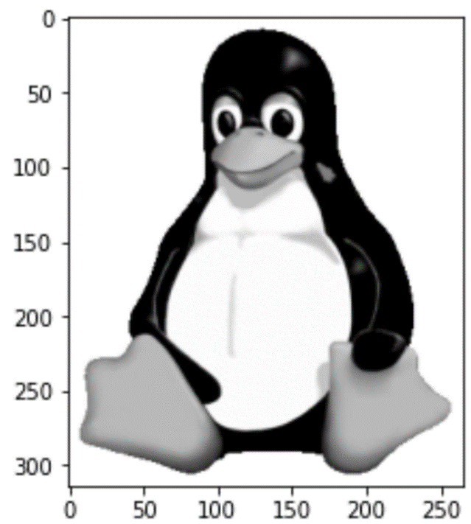

RGB to Grayscale using the 30% of Red cones, 59% of Green cones, and 11% of Blue cones in the human eye.
Size
https://en.wikipedia.org/wiki/Tux_(mascot)#:~:text=Tux%20is%20a%20penguin%20character,depict%20Tux%20in%20various%20styles.
Notes:
Numpy is another library that is very useful for working with numbers in general, we use it for working with number arrays. This rgb_to_gray function converts a 3-dimensional array to a 2 dimensional array, using the percentage of specific cone colors in the human eye to determine how much of each array is factored into the gray values.

Slide 14
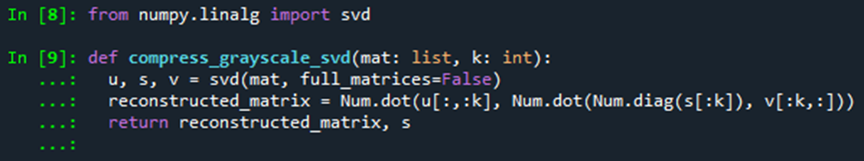
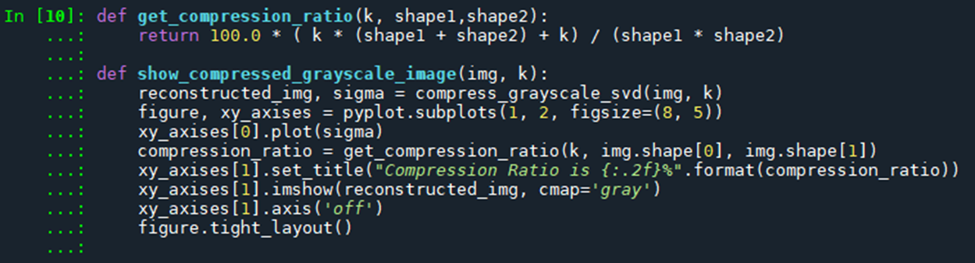
Implement SVD compression, showing the compression ratio, compressed image.
Notes:
This implements the SVD I mentioned at the start of this section, where the parameter k is amount of ranks that are kept. After doing this it returns the matrix in how it would look after compression. This is not the compressed image, it is merely how the image would look after being run through the decompression side of the algorithm and would be stored in a file in the form of the u[:,:k], s[:k], and v[:k,:] arrays.

Slide 15
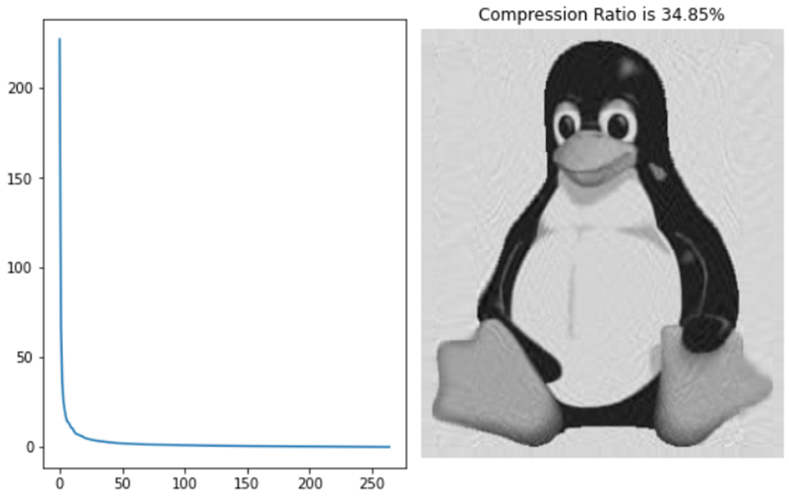

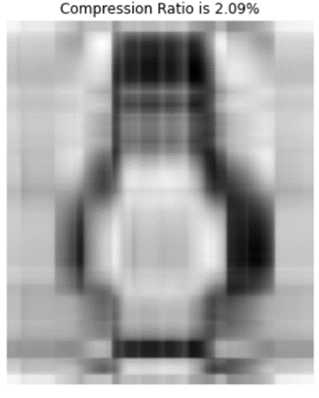
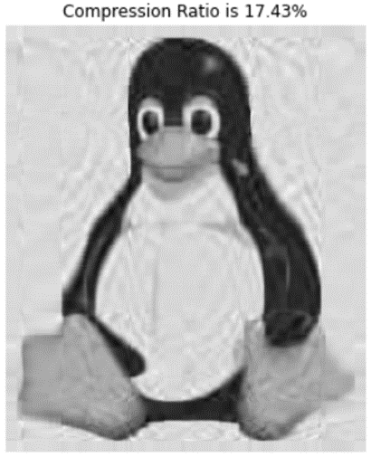
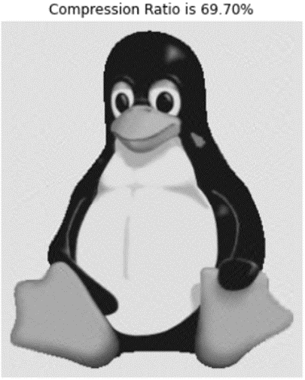
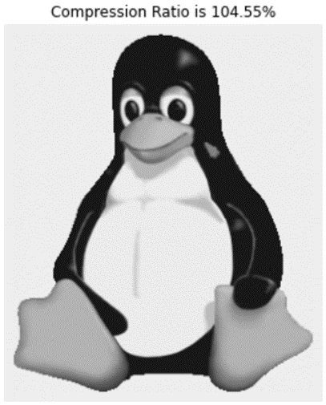
100 Singular Values (sizes in bytes)
Error
Elbow (optimized)
Singular Values
5 Singular Values
50 Singular Values
200 Singular Values
300 Singular Values

Slide 16
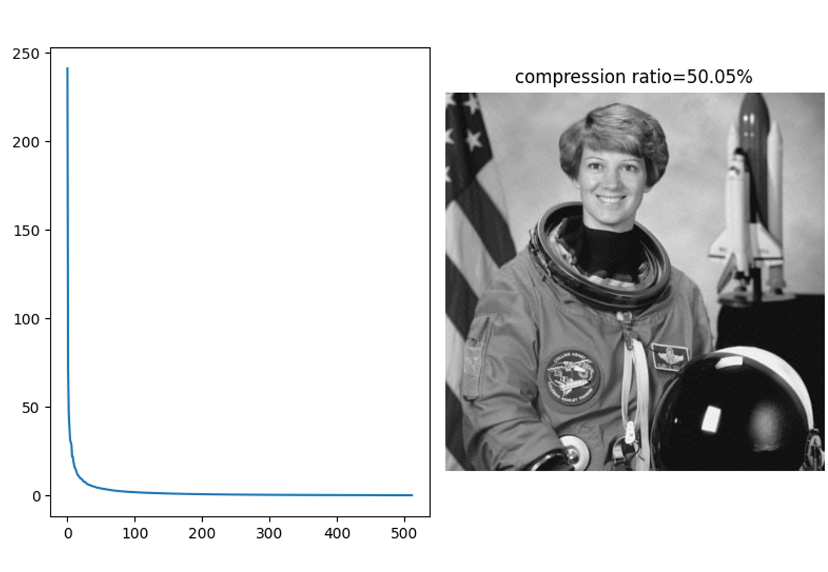
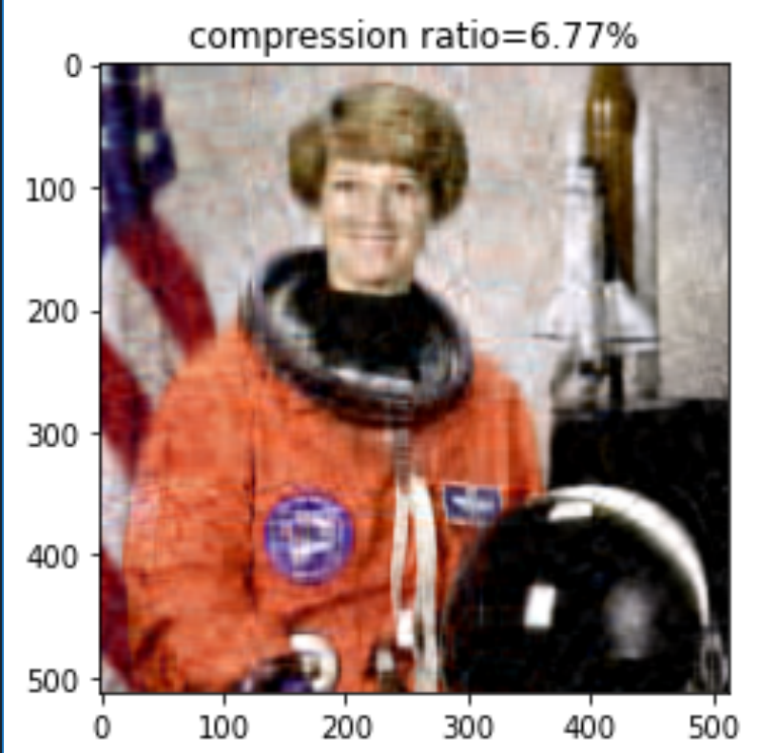
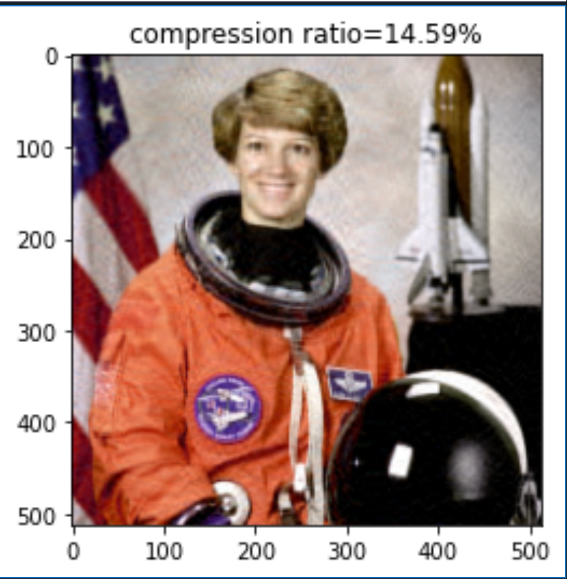

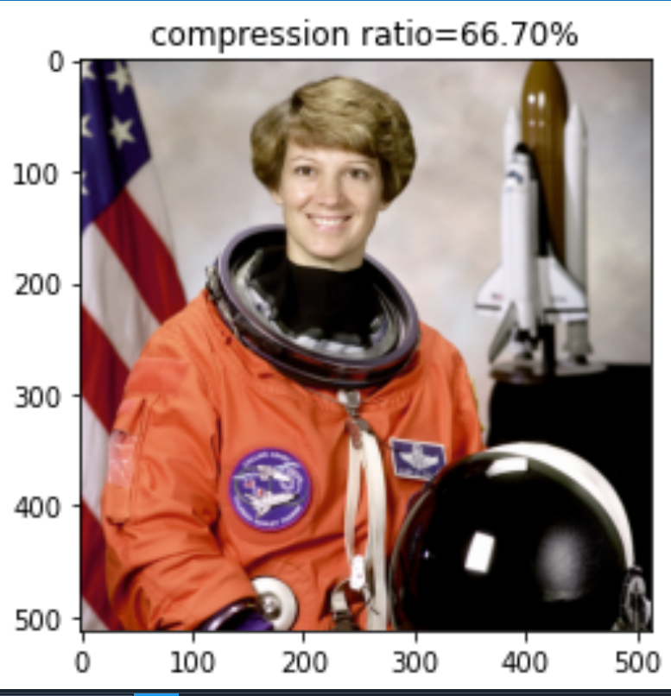
Singular Value Decomposition using NUMPY on Python to compress Color images
Color images have 3 RGB layers and we are doing SVD on all 3 layers and reconstructing image.
52
112
212
512
https://scikit-image.org/

Slide 17
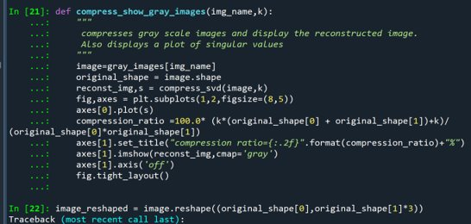

Slide 18
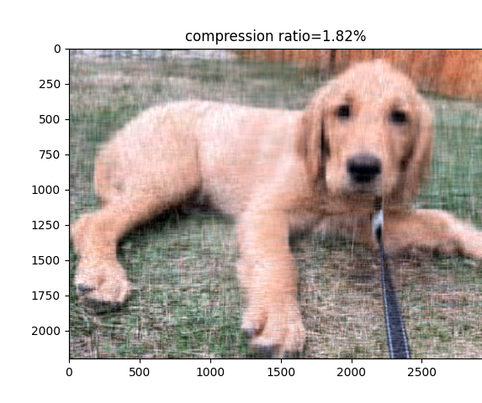

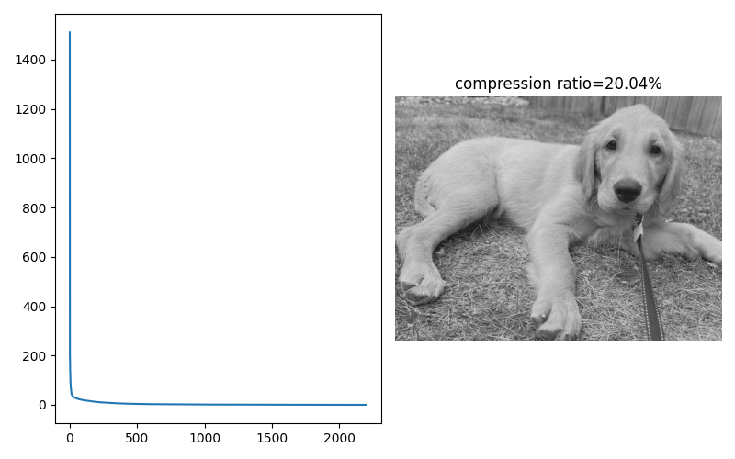



32
64
128
256
512

Slide 19
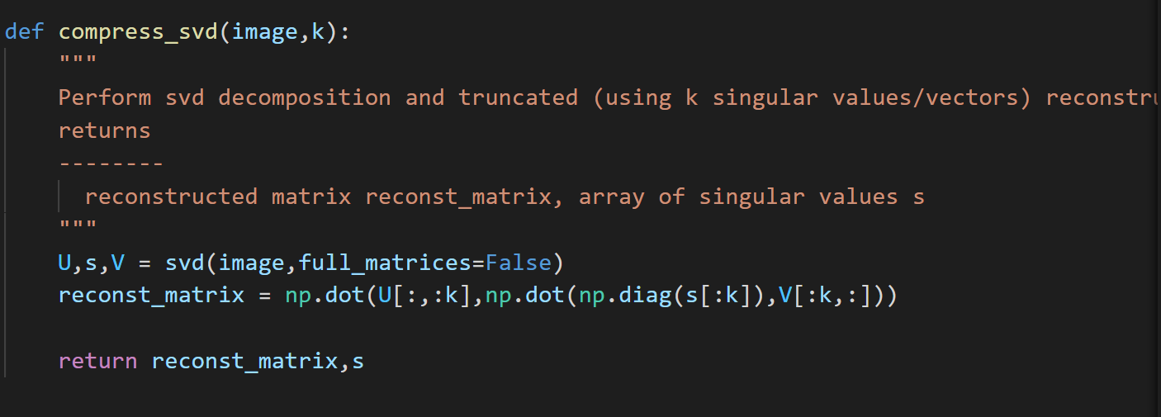

Slide 20
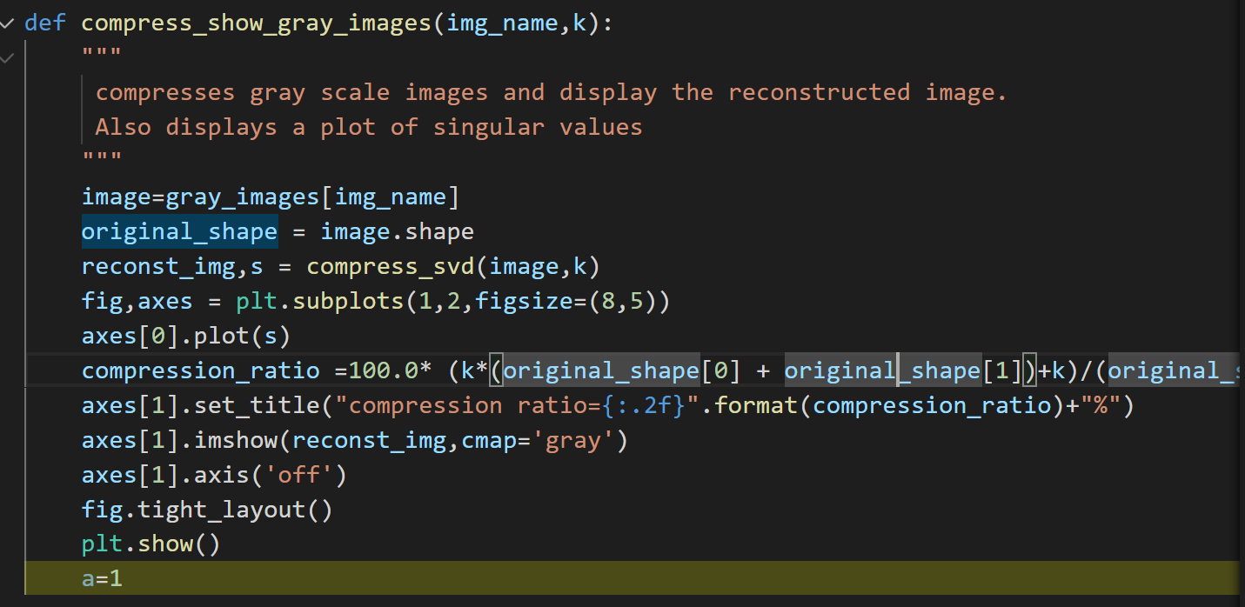

Slide 21
Conclusions
This project elucidates the key role of mathematical modeling for computer vision applications
We employed vectorization in combination with vector and scalar projections to illustrate optical Character recognition.
Singular value decomposition and PCA in combination with Python are powerful techniques that enable image compression, encryption and image identification.
Python and Teserract tools are very powerful for optical Character recognition. These techniques employ sophisticated mathematical methods for processing computer vision data.

Slide 22
Reference
Reference
https://medium.com/@rameshputalapattu/jupyter-python-image-compression-and-svd-an-interactive-exploration-703c953e44f6
https://github.com/rameshputalapattu/jupyterexplore
https://scikit-image.org/
https://devopedia.org/principal-component-analysis
Our Code Repository
https://github.com/Nick-Shadow/svdworking

