Slide 1
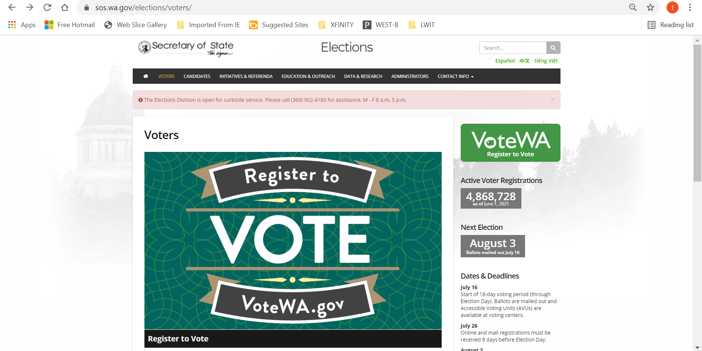
How to Register to Vote in WA - 1
If you are 16, you can register as a Future Voter!

Slide 2
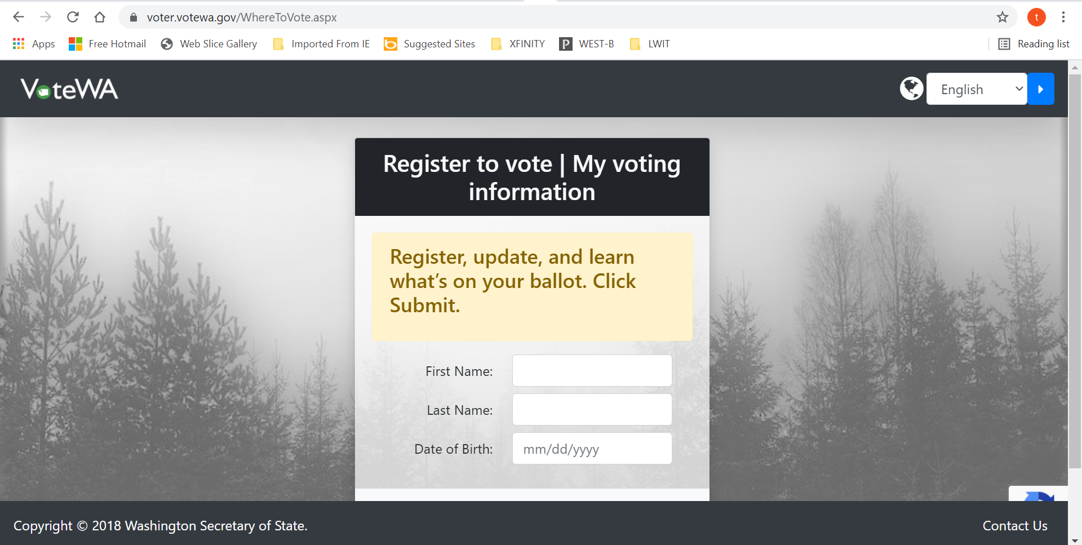
How to Register to Vote in WA - 2
votewa.gov

Slide 3
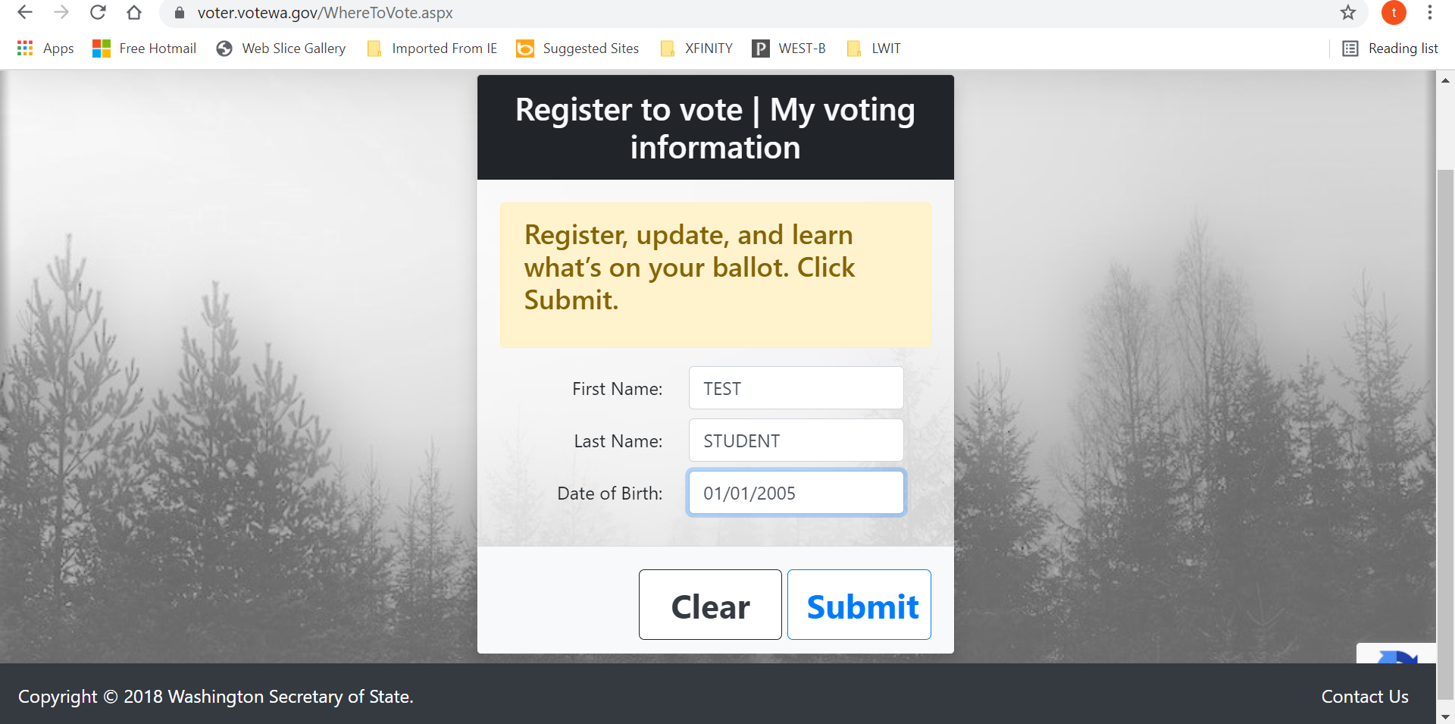
How to Register to Vote in WA - 3

Slide 4
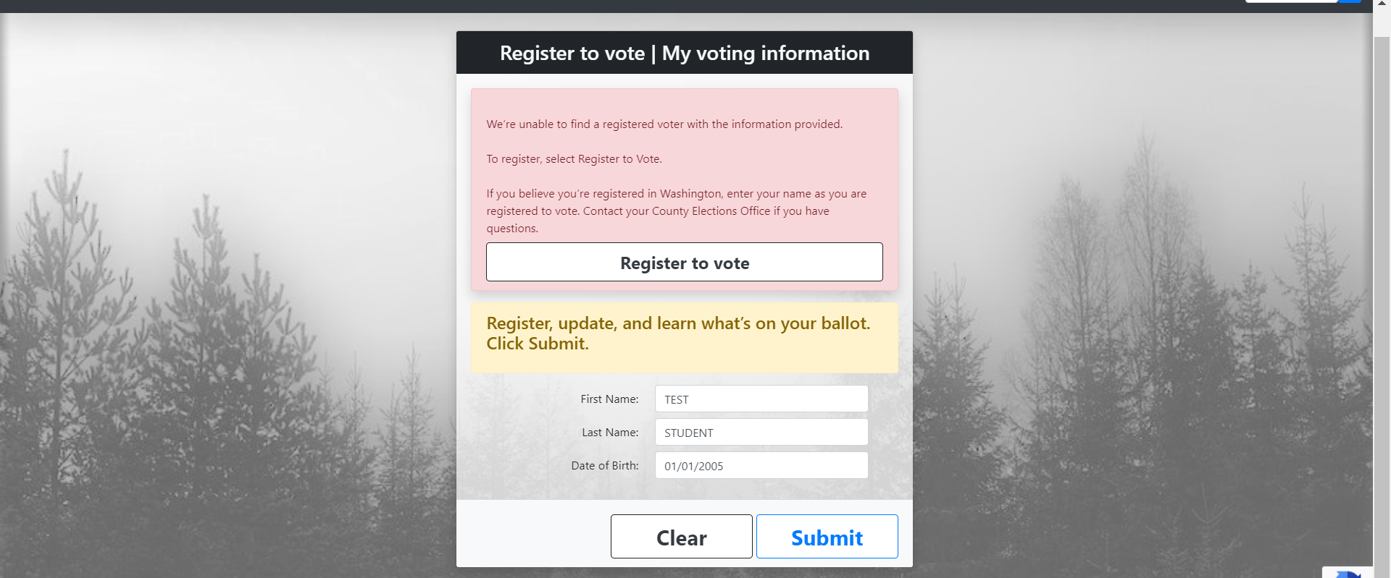
How to Register to Vote in WA - 4

Slide 5
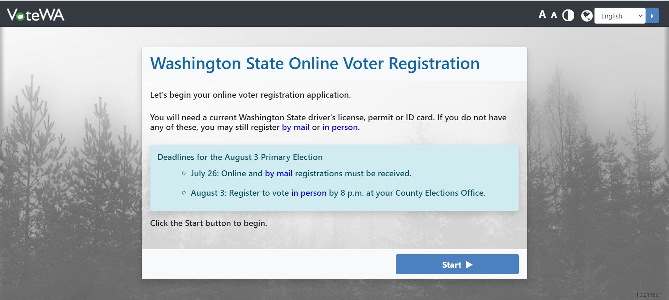
How to Register to Vote in WA - 5

Slide 6
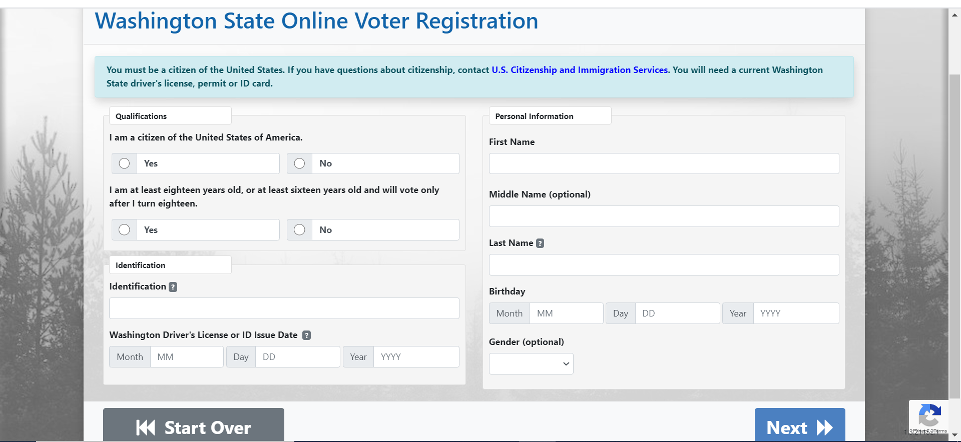
How to Register to Vote in WA - 6

Slide 7
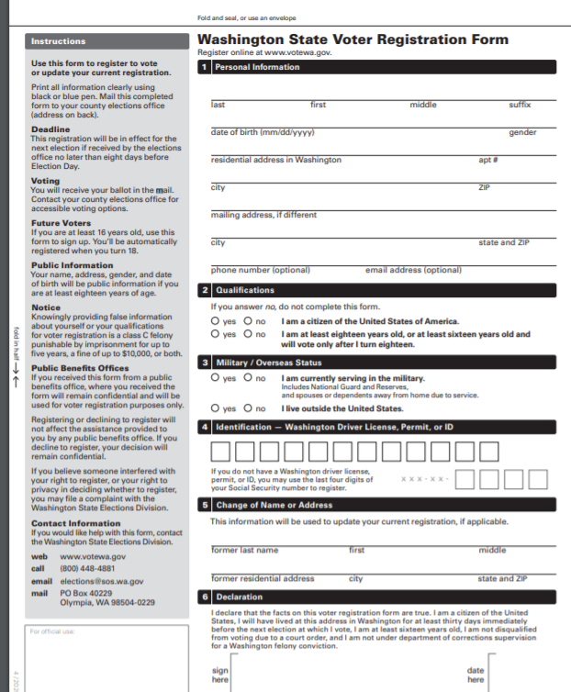
How to Register to Vote in WA - 7
The remaining parts of the on-line registration match the printed form at right. You can also download, print out and mail in this form instead of registering online.

Slide 8
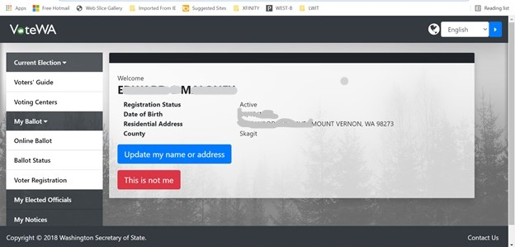
How to Register to Vote in WA - 8
You can use the same process to confirm that you are in fact registered!

