Slide 1
This Week’s Agenda
Welcome!
Important issues
Course themes
Introductions (small groups)
Course details/overview
Stories of America - A different narrative (small group discussions)
What’s next . . .
Questions for me?
One-on-one meetings

Slide 2
American Government – POLS&202D
Welcome!
Self-introduction
Professor Ted Maloney
Politics in America Today
Voter suppression/reform; Jan 6 attack on US Capitol
Racial injustice
Course Theme: American Government through a Social Justice Lens
Introduce yourselves – small groups
Insert photos here of: 1) people wearing Covid masks in public; 2) insurrectionists at Capitol; 3) George Floyd marches

Slide 3
SMALL GROUPS – INTRODUCTIONS
1. Your Name
2. City/town/community where you live now
3. Currently enrolled at
A. ___________ High School -OR- LWTech Academy -OR- _________(other?) . . .
B. as a ________ (HS Jr/Sr) or (College Fr/Soph)
4. Major or future career/education plans
What I like to do most in my spare time is . . .
--------------------------------------------------------------------------------------------------
6. If you couldn’t be human, what animal would you most like to be? Why?
7. Who is the person who has had the most influence on your life? How?

Slide 4
American Government – POLS&202D
One-on-one conferences (TBD)
Textbook and technology access (poll)
Canvas “tour” of our course
Key points:
Multiple ways to learn/demonstrate your learning
Challenge your thinking about government and your role
Critical reading of political news (What is true/not true?)
Questions?

Slide 5
SMALL GROUP DISCUSSION #1:
VIDEO: Bryan Stevenson TedTalk (6:09), https://www.youtube.com/watch?v=VNzEb77diyI “The urgent need for reconciliation in the U.S.” Aug 15, 2017
After viewing, answer and discuss the following:
1. What does Stevenson mean by the phrase "the narrative of racial difference"?
2. When he says that slavery was never really abolished, is he speaking literally? What is the point he is trying to make?
3. What were the "assaults" that he says his parents experienced? Why?
4. Why did the elderly man in the audience want to talk to Stevenson? How and why did he get his scars?
5. What has been your understanding of what the term "race" means or as it is generally used in society?
Photo of Bryan Stevenson here

Slide 6
SMALL GROUP DISCUSSION #2
VIDEO (length 16:43): How to deconstruct racism, one headline at a time. Baratunde Thurston, TedTalk
https://www.ted.com/talks/baratunde_thurston_how_to_deconstruct_racism_one_headline_at_a_time
After viewing, answer and discuss the questions:
6. What "system" is Baratunde Thurston describing?
7. What is the "invisible fear" that he and other Black people carry with them? What causes it?
8. What does he urge that we can do to change that system?
9. What actions (even small ones) can each of us take in our own lives to "change the story" and bring about these changes?
Photo of Baratunde Thurston giving TedTalk here

Slide 7
American Government – POLS&202D Sp 2022
American Government through a Social Justice Lens – authentic voices and stories
Bryan Stevenson – Ted Talk https://www.youtube.com/watch?v=VNzEb77diyI
“The urgent need for reconciliation in the U.S.” Aug 15, 2017
Jamestown – https://www.youtube.com/watch?v=ppvbBY3ce8Y
“How America invented race” July 6, 2020
“Race – The Power of an Illusion” https://lwtech.kanopy.com/video/race-power-illusion-0 (2003)
Insert photos here of: BLM peaceful protesters; pro-ERA marchers; LGBTQ activist; Stop Asian Hate demonstrators; Standing Rock Sioux oil pipeline protesters

Slide 8
SMALL GROUP DISCUSSION #2
After viewing the short video “How American Invented Race”, and “Race: The Power of an Illusion” answer and discuss these questions:
1. Why is Bacon's Rebellion an important event in understanding how the idea of race started and how it became associated with African slavery?
2. What does it mean that race is a “social construct” and not biologically based? What evidence from these videos supports this?
3. If race is an “idea” and not biological, how can that be used to address today’s problems of racism?

Slide 9
Police brutality against Black people
George Floyd murdered by policeman Derek Chauvin, 2020
photo
photo
Rodney King beaten by LA police, 1991

Slide 10
White Supremacy in America
Police (and other) violence against Black people in recent years
Rodney King (LA) 1991
Trayvon Martin (FL) 2012 (perpetrator acquitted)
Michael Brown (Ferguson MO) 2014
Eric Garner (NYC) 2014
Freddie Gray (Baltimore MD) 2016
Ronnell Foster (CA) 2018
Willie McCoy (CA) 2019
Breonna Taylor (Louisville KY) 2020
George Floyd (Minneapolis MN) 2020
Since 2015, police officers have fatally shot at least 135 unarmed Black men and women nationwide, an NPR investigation has found. NPR reviewed police, court and other records to examine the details of the cases. At least 75% of the officers were white. https://www.npr.org/2021/01/25/956177021/fatal-police-shootings-of-unarmed-black-people-reveal-troubling-patterns
Go to WAPO website https://www.washingtonpost.com/graphics/investigations/police-shootings-database/ & NPR’s video The Blinding Of Isaac Woodard

Slide 11
More recently . . .
The killing of George Floyd was not the last, nor the most recent, killing of a Black man by police:
https://www.reuters.com/world/us/attorneys-family-black-man-shot-dead-by-police-release-autopsy-findings-2022-04-19/

Slide 12
Nor was Rodney King . . .
. . . the earliest example of police brutality against a Black man
American Experience | Chapter 1 | The Blinding of Isaac Woodard | Season 33 | Episode 3 | PBS
Image from Isaac Woodard PBS video cover; photo of Isaac Woodard

Slide 13
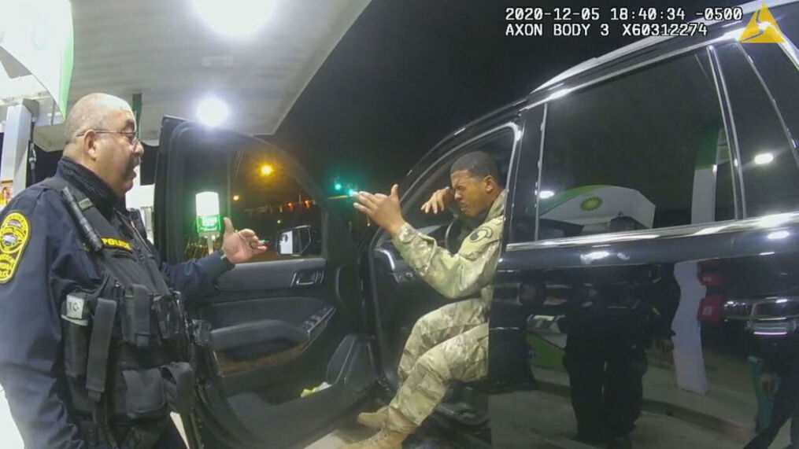
Nor was Isaac Woodard . . .
. . . the last Black soldier to be brutalized by police.
Prosecutor reviews case of Army officer who was hit with pepper spray during traffic stop - ABC News (go.com)

Slide 14
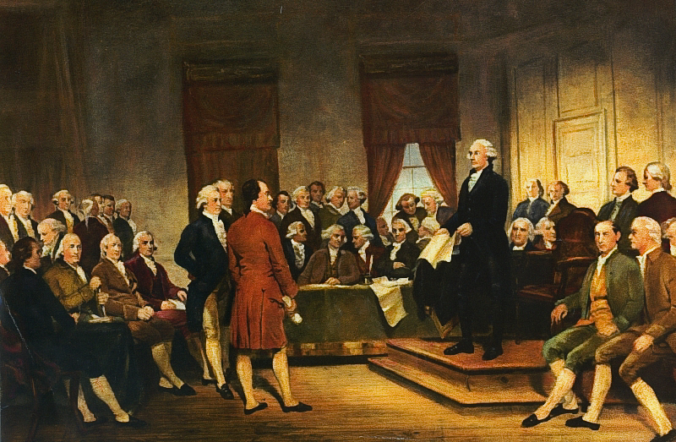
White Supremacy (cont.)
1650s - Jamestown and the invention of “whiteness”; slavery and “slave patrols”
1787 - Constitution created by white men allows slavery to continue
1860 - South secedes from the Union over efforts to abolish slavery
1877 - End of Reconstruction in the South birth of “Jim Crow” – KKK – lynching – segregation – voter suppression
1896 - Segregation by race approved as “separate but equal” by Supreme Court (Plessy v. Ferguson)
1954 – Brown v. Board of Education Supreme Court overrules “separate but equal”; southern states resist desegregation
1965 - Voting Rights Act passed to remedy voting restrictions against Blacks
Various images here reflecting key moments in history of white supremacy: screen capture from video How America Invented Race (first use of “white” person in a law); painting of Constitutional Convention in Philadelphia (see above); image of US map showing southern states seceding; KKK burning cross; “colored” drinking fountain in South during Jim Crow; Little Rock student surrounded by angry white mob; Police beating Selma marchers in 1965.

Slide 15
White Supremacy (cont.)
Video clip from MSNBC showing GA Gov. Brian Kemp announcing voter restrictions
Photo of protesters against Georgia voting restrictions
Dual photos showing GA Gov. Brian Kemp signing voting restrictions into law amidst white legislators, while Black legislator arrested outside room for seeking entry
Voter suppression today
By March 24, 2021, legislators had introduced 361 bills with restrictive provisions in 47 states.

Slide 16
White Supremacy (cont.)
Key Concepts & Definitions
Race is a social construct (idea), not biological
Prejudice vs. racism
One common definition: “Racism is any prejudice against someone because of their race.”
A better definition: “Racism is any prejudice against someone because of their race, when those views are reinforced by systems of power.”
Systemic racism
White privilege:
“An advantage or set of advantages that you have that others do not, based on your ‘whiteness’.”
Micro-aggressions
“Small daily insults and indignities perpetrated against marginalized or oppressed people because of their affiliation with that marginalized or oppressed group.”

Slide 17
Social Justice: Power, Privilege & Inequity
Dominant group enjoys privileges denied a subordinate group
“social identity” - ties us to dominant and/or subordinate groups through socialization
EXAMPLE: white woman loses job promotion to less qualified white man
She experiences oppression as a member of a subordinate group (women) even while enjoying privileges as part of a dominant group (white) – this is systemic discrimination based on sex
Overlapping social identities = “intersectionality”
Examples of other social identities in dominant/subordinate categories?
What are your own social identities? Where do they come from? Where do they fit within dominant/subordinate groups?

Slide 18
Social Justice: Power, Privilege & Inequity
Solutions?
Understanding the history and nature of racial oppression and white supremacy, and other forms of oppression of marginalized groups
“marginalized” – on the margins of society, not a full participant in the benefits (privileges) enjoyed by the majority
Listening to the voices of those who have been marginalized
Learning their stories of oppression and their struggles against it
Learn about the current issues affecting marginalized communities
Equity is necessary to achieve Equality
Become engaged with others who are seeking social justice
participate and/or lead, if you are a member of a marginalized group
Become an ally if you are not a member of a marginalized group
Government = politics = power: who wants it, who has it, who uses it

