Slide 1
The Declaration of Independence: The Second Continental Congress
The committee included:
Thomas Jefferson of Virginia
Benjamin Franklin of Pennsylvania
Roger Sherman of Connecticut
John Adams of Massachusetts
Robert Livingston of New York
In 1776, the Second Continental Congress appointed a committee to draft a statement of independence.

Slide 2
Historical Context: Why rebel v England?
1619 – first African slaves to Jamestown, Virginia
1680 – after Bacon’s Rebellion Virginia begins passing “race” laws
1763 – End of Seven Year’s War (Europe), aka French and Indian War (N. America)
1765-1767 – Stamp Act and Townshend Acts (British Parliament taxation of American colonists to pay debts from the wars);
1773 –Tea Act (British Parliament grants monopoly to British East India Tea Co. to help stave off bankruptcy)
1773 – Boston Tea Party

Slide 3
Historical Context (cont’d)
1774 – Coercive Acts (aka Intolerable Acts) – mainly aimed at Massachusetts colony
- Boston Harbor Act, Massachusetts Government Act, Administration of Justice Act, Quartering Act (all colonies)
1774 – First Continental Congress (colonies pledged boycott and mutual military support)
1775 – Battles of Lexington and Concord; Second Continental Congress
1776 – Declaration of Independence
1777 – Articles of Confederation adopted and sent to states; ratification (1781)
1783 – Treaty of Paris – official end of Revolutionary War

Slide 4
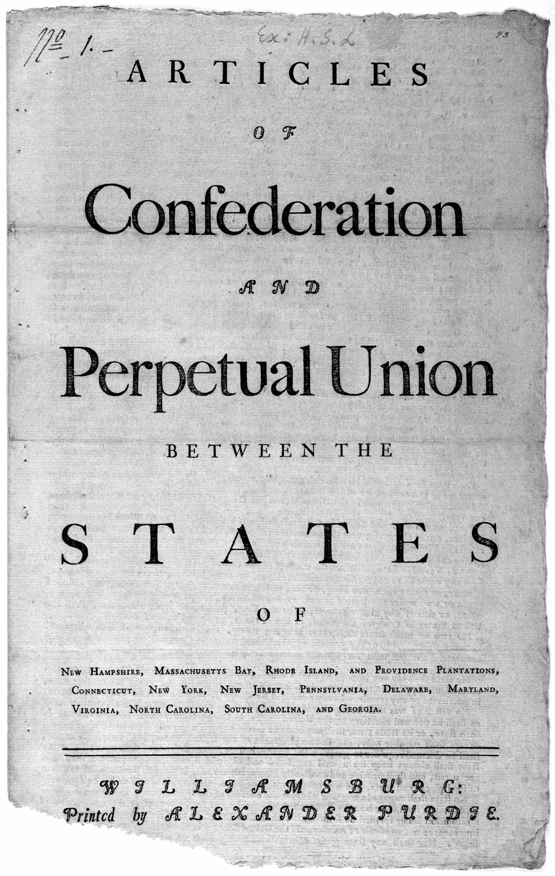
The Articles of Confederation
After declaring independence, the Continental Congress adopted the Articles of Confederation.
Articles of Confederation (1777–1789)
This was the first written constitution of the United States.
It was ratified by all states in 1781.
The state governments retained “sovereignty, freedom, and independence” (making them a confederation).
“police powers” – inherent authority to regulate the health, safety, welfare & morals of its citizens
Notes:
Students may never have heard of the Articles. Stress the term Confederation, meaning that the states retained their respective sovereignty except for the powers expressly delegated to the national government.
Discuss the rationale behind designing such a weak government.
The colonists distrusted strong central government; they had just rebelled against such a system.
They wanted government literally close to home. The distance between the colonists and the British posed considerable strain on representation. They were likely to be more trusting of state government representatives they were more familiar with and who were accountable to their particular state.
The states did not want to concede their new and emerging economic and political power to a central government (no one wants less power).

Slide 5
The Second Founding: The Three-Fifths Compromise
To build support for the Constitution, slave and nonslave states needed to reach a compromise.
Three-Fifths Compromise
Seats in the House would be apportioned by “population,” with counting five enslaved persons = three free persons.
Southern delegates would not agree to the new government if northerners refused to bargain on this issue.

Slide 6
DISCUSS: Could U.S. slavery have been abolished in 1787?
"Had the Constitutional Convention forced the hand of the Southern colonies by denying the three-fifths compromise, could North and South have existed as separate nations? * * * In the United States, the decision to empower the slave-holding South via the three-fifths compromise — and it was a decision — led to the enslavement of over 4 million blacks by the time of the Civil War; the loss of as many as 750,000 lives during the Civil War; and the development of a racism that oppressed the opportunities of many millions more Americans of African descent long after slavery’s end."
Prof. Leslie M. Harris, Emory University
"The Northern nation, free of bondage and southern hostility to internal improvements, would have used the national power to build canals, a national university system, banks, railroads and a powerful economic infrastructure. A great northern United States would have emerged, alongside a decadent slave-owning plantation culture economically dependent on its northern neighbor."
Prof. Paul Finkelman, Albany Law School
"There was justified fear that the dissolution of the existing United States would, as in Europe, lead to endless warfare among the two or three separate countries, which would inevitably enter into 'entangling alliances' with European powers eager to work their will in the 'New World.'"
Prof. Sanford Levinson, University of Texas Law School

Slide 7
SEPARATION OF POWERS—CHECKS & BALANCES—FEDERALISM
CLASS EXERCISE
SEPARATION OF POWERS—CHECKS & BALANCES—FEDERALISM
1. House of Representatives votes to approve a bill requiring vote by mail in every state. If Senate doesn’t like it, what can it do? If President likes it, what can President do?
2. Senate votes to approve a bill banning medication abortion in all states. If House doesn’t like it, what can it do?
3. House and Senate both vote to approve a bill requiring manufacturers to reduce plastic in their products by 30% by 2030. If President doesn’t like it, what can President do?
4. President vetoes a bill passed by Congress that guarantees in every state a woman’s right to terminate her pregnancy. What can Congress do?
5. President signs into law a bill passed by Congress that lowers the voting age to 16. If state of Texas doesn’t agree, what can it do?
6. Congress passes a bill that requires government-issued voter ID for citizens to vote, and President signs into law. If a citizen will be denied the right to vote because of this requirement, what can they do?

Slide 8
SEPARATION OF POWERS—CHECKS & BALANCES—FEDERALISM
CLASS EXERCISE
SEPARATION OF POWERS—CHECKS & BALANCES—FEDERALISM
7. President nominates a transgender woman judge to be a justice on the US Supreme Court. Who has the power to stop this judge from joining the Court? How?
8. President orders US troops to invade Portugal. Who can stop this? How?
9. President orders US military to arrest and imprison all members of Congress. Who can stop this? How?

