Slide 1
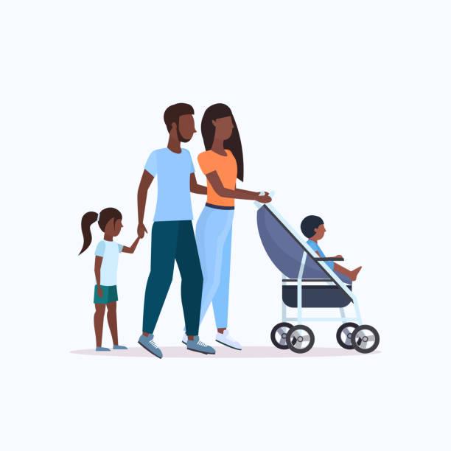
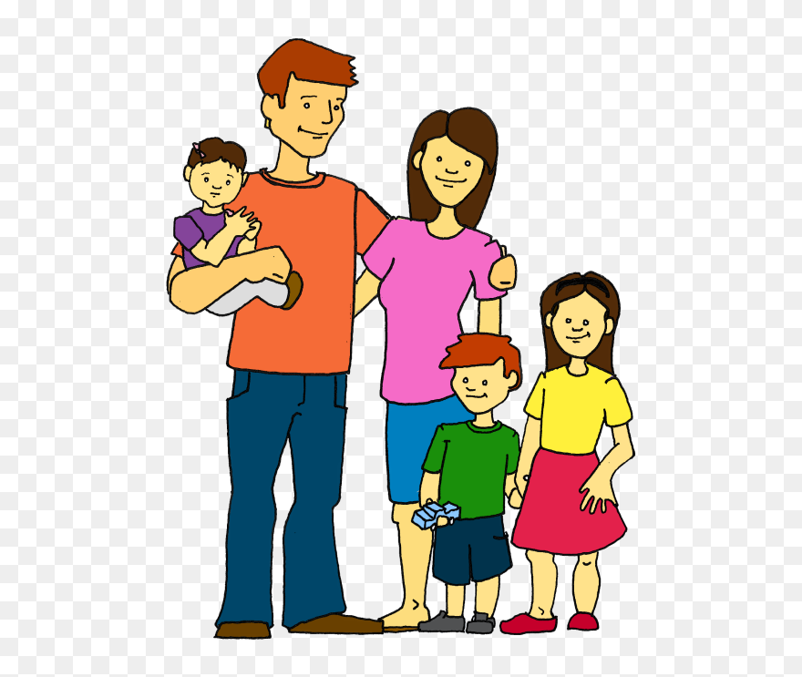
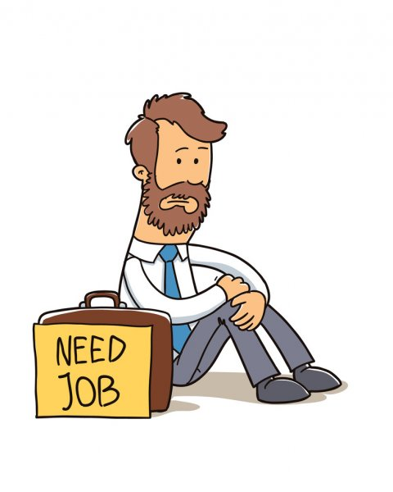
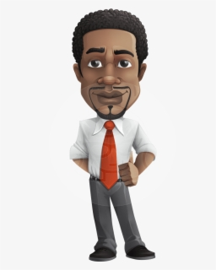
The Racial Divide Today: Socioeconomic Indicators
The ECONOMIC gap
Poverty 1:3
Wealth 6:1 $$$$$$ $
Unemployment 1:2
The HEALTH gap
On every measure of health, there is a large gap between whites and blacks.
"In short, rather than validating long-debunked hypotheses about intrinsic biological susceptibilities among non-White racial groups, the evidence to date reaffirms that structural racism is a critical driving force behind COVID-19 disparities.“ https://www.cidrap.umn.edu/news-perspective/2020/09/studies-spotlight-covid-racial-health-disparities-similarities
Notes:
“Environmental racism” refers to the fact that many minority groups are more likely to live in areas affected by pollution, toxic waste and chemical sites. The case of public water in Flint, Michigan is instructive: the residents are overwhelmingly poor and black. Despite the city’s residents reporting that their water was unsafe to drink, the local and state government ignored their complaints. As a result, some 6,000 to 12,000 residents had elevated blood levels and serious health issues due to the unsafe water.

Slide 2
White Supremacy (cont.)
Key Concepts & Definitions
Race is a social construct (idea), not biological
Prejudice vs. racism
One common definition: “Racism is any prejudice against someone because of their race.”
A better definition: “Racism is any prejudice against someone because of their race, when those views are reinforced by systems of power.”
Systemic/structural racism: racism embedded in the structures of society, often invisible to those unaffected by them.
White privilege
“An advantage or set of advantages that you have that others do not, based on your ‘whiteness’.” (also often invisible to the privileged person)
Micro-aggressions
“Small daily insults and indignities perpetrated against marginalized or oppressed people because of their affiliation with that marginalized or oppressed group.”

Slide 3
Social Justice: Power, Privilege & Inequity
Dominant group enjoys privileges/advantages denied a subordinate group
“social identity” - ties us to dominant and/or subordinate groups through socialization
EXAMPLE: white woman loses job promotion to less qualified white man
She experiences oppression as a member of a subordinate group (women) even while enjoying privileges as part of a dominant group (white) – this is systemic discrimination based on sex
Overlapping social identities = “intersectionality”
Examples of other social identities in dominant/subordinate categories?
What are your own social identities? Where do they come from? Where do they fit within dominant/subordinate groups?

Slide 4
A simple illustration of systemic discrimination - Lefties
The spray bottle in the photos is designed for right-handed people. When left-handed users set the bottle down in the same manner as right-handers would, the front label faces backwards, making it less convenient to find for the next use. The company’s design team didn’t intend to discriminate against left-handers, they just designed in a way that was familiar to them.
Dominant groups (90% of population is righthanded) make things and rules that work for them, often without thinking how non-dominant groups might be impacted. This privilege/advantage of being right-handed is “invisible” to right-handed people because it is “normal” for them and they are never inconvenienced or harmed by it. Dominant group privilege is generally invisible to dominant group members and systems put in place are not necessarily created out of prejudice.

Slide 5
What are your socialized identities?

Slide 6
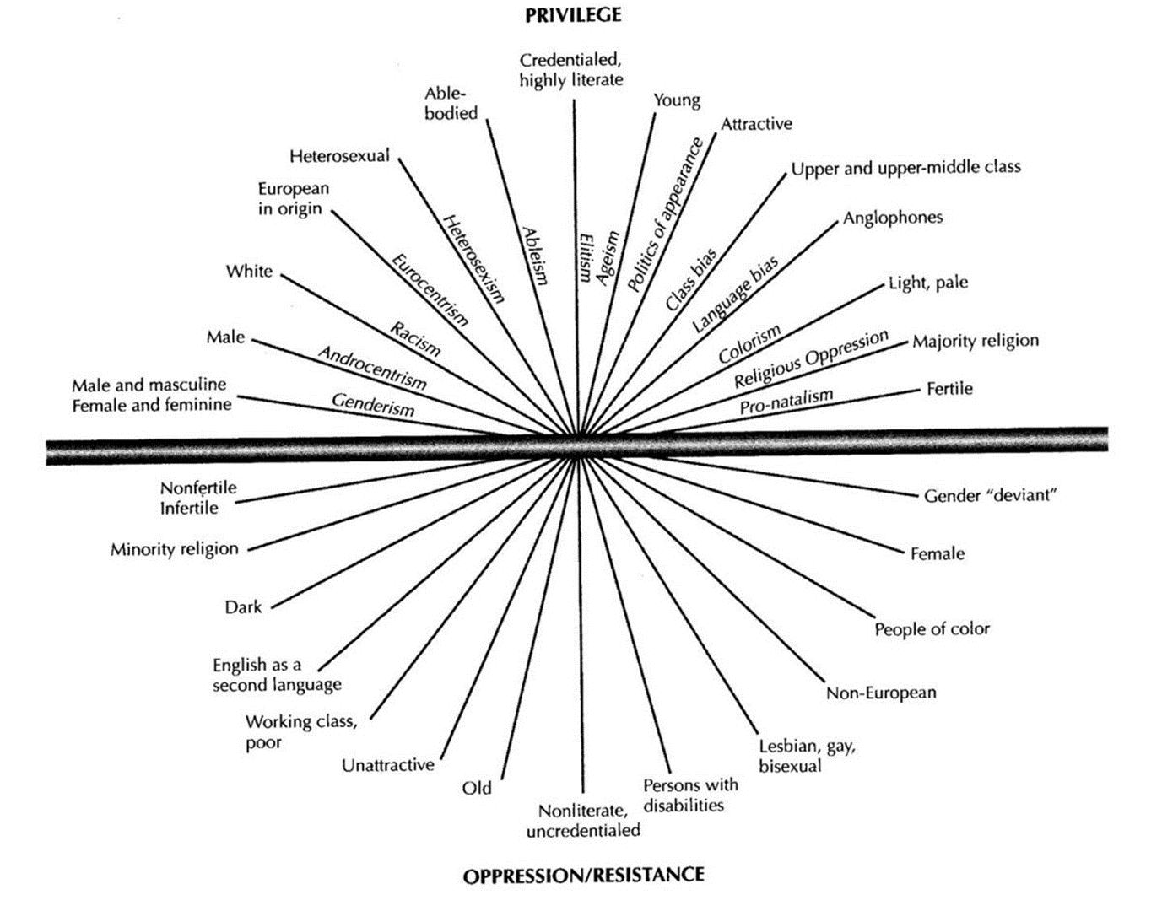
Identity Matrix - Where do you fit in?
1. Color-highlight the lines that best describe your own identity based on classifications shown. Color in as many categories as you can and are willing to share - DO NOT WRITE YOUR NAME ON IT - it will be posted on the wall in class along with everyone else's.
3. After all charts are posted on the wall, we will have a "walk-by" for each of you to take a closer look at other students' posts.
4. After the walk-by, write a brief reflection about this exercise, using the following questions as a guide:
a. Is your own identity mainly above or below the horizontal middle line?
b. Are there ways that part of your identity gives you an advantage? If so, how? If part of your identity is a disadvantage in our society, have you experienced it yourself? If so, how?
c. Add any other comments or reflections on what you discovered by doing this exercise - did anything surprise you? Did it help you see where you may have more advantages (or disadvantages) than others in some areas?

Slide 7
Social Identity Matrix – what are my social identities?
1. Complete the matrix form using a colored pen. Shade along the lines that you feel apply to your own identity – make the line longer or shorter to represent how important you feel that feature is to your identity. DO NOT WRITE YOUR NAME ON IT.
2. Post your completed matrix randomly on the board.
3. After all are posted, I will ask the entire class to file past them and take a few moments to note for yourself any observations or reactions.
4. When you return to your seat, use the paper provided to “ink shed” (write) ANONYMOUSLY for no more than 5 minutes what observations you made or reactions you have to your own social identities and those of your classmates as a whole. DO NOT WRITE YOUR NAME ON THE PAPER – I will collect them and review them later.

Slide 8
Social Justice: Power, Privilege & Inequity (cont.)
Solutions for Social Injustice?
Understanding the history and nature of racial oppression and white supremacy, and other forms of oppression of marginalized groups
“marginalized” – on the margins of society, not a full participant in the benefits (privileges) enjoyed by the majority
Listening to the voices of those who have been marginalized
Learning their stories of oppression and their struggles against it
Learn about the current issues affecting marginalized communities and the solutions that they want
Become more aware of our own biases (Try the IAT - Implicit Association Test: https://implicit.harvard.edu/implicit)
Understand the difference between Equality and Equity.
Become respectfully engaged with others who are seeking social justice
participate and/or lead, if you are a member of a marginalized group
Become an ally if you are not a member of a marginalized group (use your privilege)

Slide 9
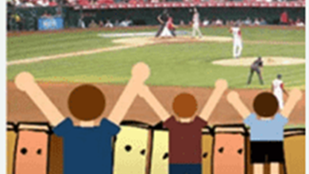
Social Equity and Systemic Solutions
This slide showed a familiar image used to demonstrate the difference between “equality” and “equity” – 3 kids of different heights trying to watch a baseball game from behind a wooden fence. Different size boxes to stand on helped the 2 shorter kids (“unequal” treatment to produce “equitable” results, e.g., “affirmative action”), but replacement of the wooden fence with a chain link fence provided a systemic solution.
The full image can be found online for temporary education, or with permission from its creator, Professor Craig Froehle, PhD.

Slide 10
A Quick Overview of selected marginalized communities
Native American (American Indian tribal) communities
Latinos/Hispanic communities
Women
LGBTQ communities
Asian American communities

Slide 11
Native Americans - North American continent, pre-Columbian
1492 CE
562 distinct tribal groups
Population estimates range 8 to 112 million; by 1650, 6 million – decline caused mostly by disease brought by Europeans
(unable to ascertain image source)

Slide 12
Native Americans and Louisiana Purchase - 1803

Slide 13
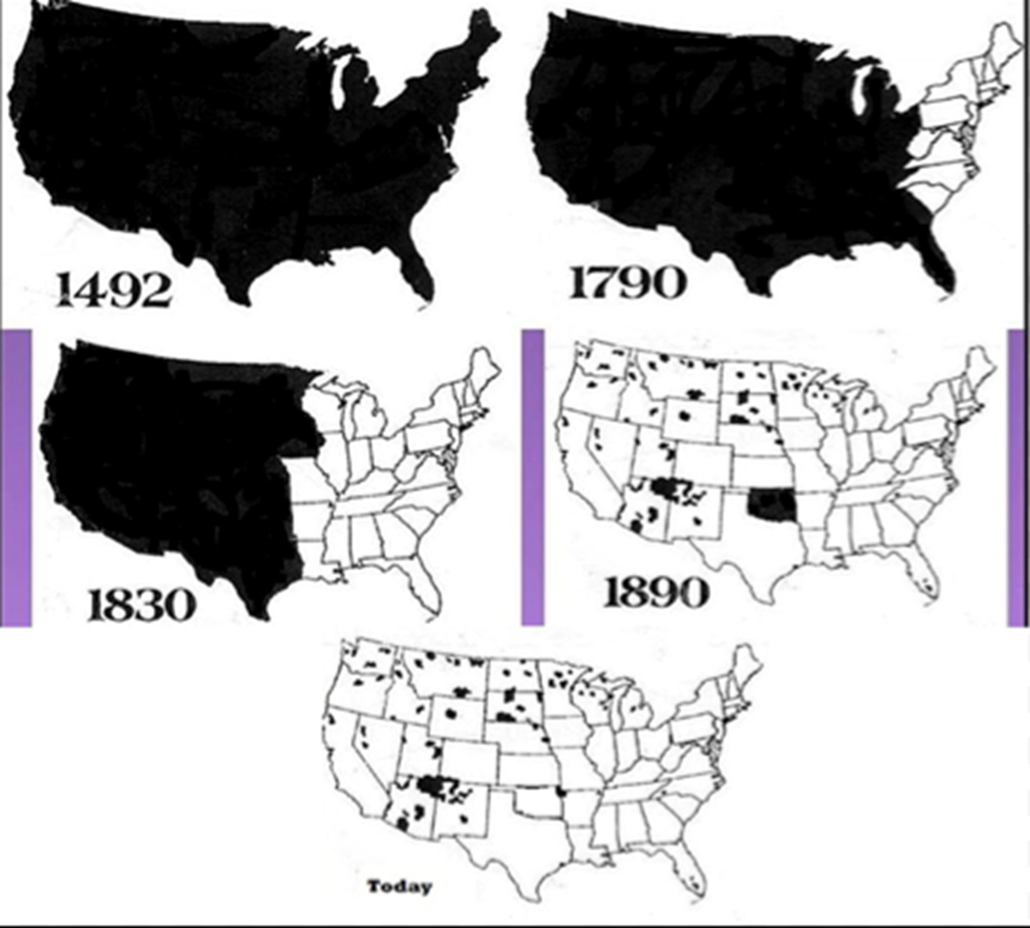
Native Americans and the Context of Civil Rights
Laws of European nations – cannot take occupied lands by “discovery” or unjust war. Indigenous lands must be purchased or acquired by treaty, one sovereign to another.
But most treaties that Native Americans signed with the U.S. government were broken or ignored.
Native Americans were systematically removed from their lands and often killed (“Five Civilized Tribes” case).
Removed to reservations, prevented from voting until 1924
1880s -1920s Assimilation and Allotment - “surplus” reservation lands were given to whites (e.g., Yakama, Swinomish reservations)
1934 – Indian Reorganization Act restored tribal governments, ended assimilation policy
1950s – Congress terminated some tribes’ legal status(e.g., Klamath in Oregon)
1975- Indian Self-Determination Act
Indian lands through history

Slide 14
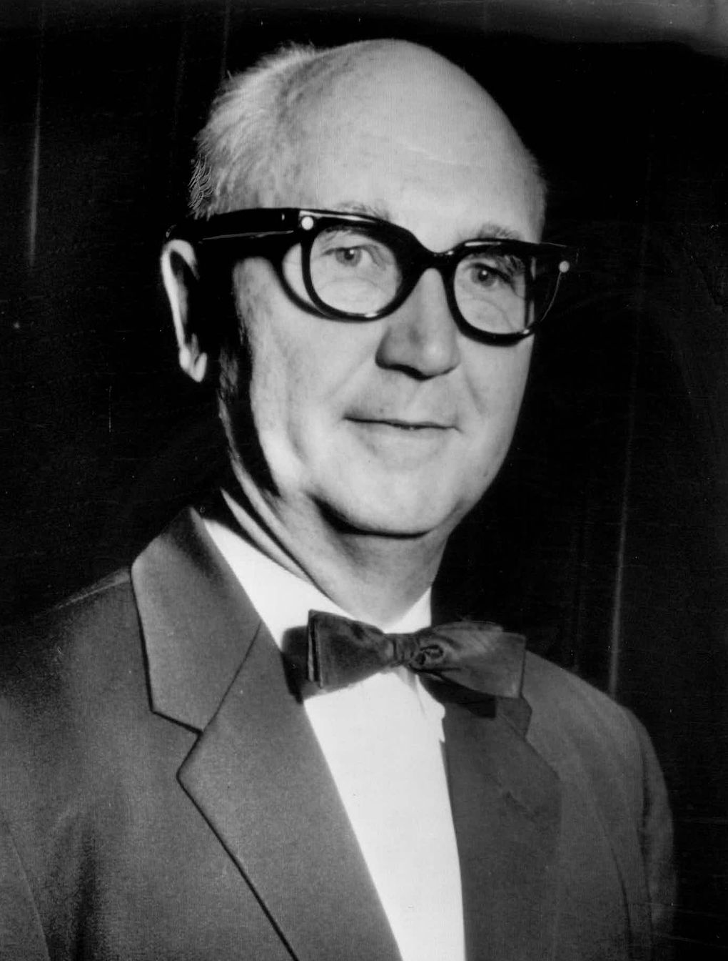
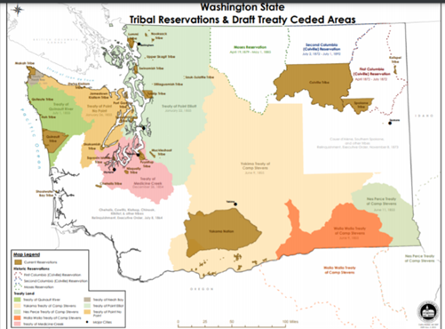
Native Americans - Indian Treaty Rights in Washington state
1855 – Stevens treaties with WA tribes – land for reserved rights (fishing, hunting)
1974 – Federal judge blocks WA state officials from denying Indians fishing rights at traditional locations (Boldt decision)
1979 – US Supreme Court upholds key elements of Boldt decision.
Today – Tribes are co-managers of fisheries with state.
Judge Boldt

Slide 15
Native Americans - Dakota Access Pipeline
Standing Rock Sioux Tribe led protests in 2016-17 against an oil pipeline that they claimed would endanger their drinking water supply and damage ancestral burial grounds. Protesters encamped on construction site.
President Trump ordered government to expedite construction of pipeline.
March 25, 2020 – Federal judge orders full environmental review (3 years after oil began to flow)
Jan 2021 – DC Court of Appeals upholds federal judge’s order
https://www.pbs.org/newshour/nation/dakota-access-pipeline-operation-months-resistance
Insert photos showing encampment of protesters at Standing Rock Sioux oil pipeline protests
Notes:
Native Americans’ struggles to maintain the security of their cultural lands were at the forefront of controversy over the construction of the Dakota Access Pipeline. In 2016 and 2017, the Standing Rock Sioux tribe led protests against the oil pipeline and its proposed route, which threatened their ancestral lands and clean water supply.

Slide 16
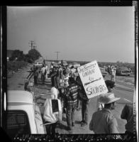
Latino communities; Immigrant rights
Latinos are now largest minority group
Latinos have struggled for political and economic equality.
Cesar Chavez and Farmworker rights
Latinos lack the political clout of African Americans, because
Vote at a lower rates
More politically diverse
Immigrant Rights:
Dreamers & DACA
https://www.haasjr.org/about/timeline/immigrant-rights
Notes:
As the number of Latinos in the U.S. increases, do you think they will wield more power in the future? Why?

Slide 17
Women and Civil Rights
Women have long been held out of political action (“All MEN are created equal”)
Abigail Adams (wife of 2nd President John Adams), on eve of Declaration of Independence, warned her husband: “[W]e (women) will not hold ourselves bound by any laws in which we have no voice or representation.”
Women only won the right to vote in 1920 after years of marches, demonstrations, civil disobedience and jailing of their movement leaders.
Laws against women owning property motivated by protectionism
Women today earn 75% of men for similar work; continue to fight for equal pay, reproductive rights under state laws and against sexual harassment and domestic violence.
Notes:
While the view that men need to protect women, and that women need to take care of the home and family, is on the decline, elements of protectionism have guided the Supreme Court’s actions as recently as 1961.
Justice Joseph Bradley provided a clear example of protectionism when he said, “The civil law as well as nature itself has always recognized a wide difference in the respective spheres and destinies to man and woman. Man is, or should be, women’s protector and defender. The natural and proper timidity and delicacy which belongs to the female sex evidently unfits it for many of the occupations of civil life. The constitution of the family organization which is founded in the divine ordinance, as well as the nature of things, indicates the domestic sphere as that which properly belongs to the domains and functions of womanhood.”

Slide 18
Sexual Harassment and #MeToo
1991 - Law professor Anita Hill testified against Clarence Thomas, her former boss, accusing him of sexual harassment, during his Supreme Court nomination hearings in the Senate.
2017.Allegations of sexual assault by Hollywood mogul, Harvey Weinstein
Many other women share their stories with the hashtag #MeToo.
https://www.youtube.com/watch?v=fSbFFwHDzQo&feature=emb_logo
2018 Christine Blasey Ford testifies at Brett Kavanaugh’s Supreme Court confirmation hearing that he sexually assaulted here when they were both in high school.
Photos of Anita Hill and Clarence Thomas from Senate Judiciary committee hearings 1991
Photo showing arrest of Harvey Weinstein
Photos of Brett Kavanaugh and Christine Blasey Ford testifying before Senate Judiciary committee in 2018

Slide 19
LGBTQ Community and the Context of Civil Rights
The LGBTQ community is the most recent group to engage in the struggle for civil rights.
Political action began with the Stonewall Rebellion in 1969.
https://www.youtube.com/watch?v=Q9wdMJmuBlA&feature=emb_logo
Support for gay rights has grown substantially in the 50 years since.
2015: Supreme Court rules that gay marriage is legal nationwide.
Insert photo of demonstrators in front of Stonewall Inn commemorating anniversary of original protest.
Insert photo of pro-LGBTQ demonstrators in front of US Supreme Court
Notes:
The riots that took place after police raided the Stonewall Inn in New York City galvanized the gay community and helped propel them into action.

Slide 20
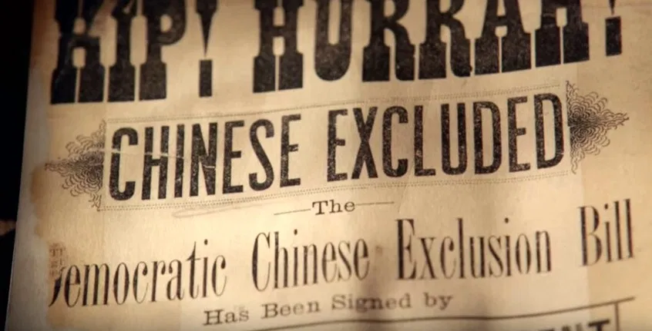
Chinese Americans and Civil Rights
Experienced discrimination with arrival in 1800s
Chinese miners and railroad workers victims of violence
In 1882, Congress attempted to deny Chinese immigrants from becoming citizens (Chinese Exclusion Act)
Violence against Chinese in Seattle
Notes:
The first wave of Chinese immigrants came during the 1848 gold rush in California. Chinese workers played critical role in completing the transcontinental railroad, yet were victims of violence and discrimination. The Chinese Exclusion Act of 1882 specifically banned any immigrants from China, and sought to prevent any Chinese immigrants already in the United States from becoming citizens, though the Supreme Court granted automatic citizenship to any American-born children under the Fourteenth Amendment.
The U.S. government has officially apologized to Japanese Americans after their internment in WWII, admitting that it was a “grave injustice” that was motivated by racial prejudice.

Slide 21
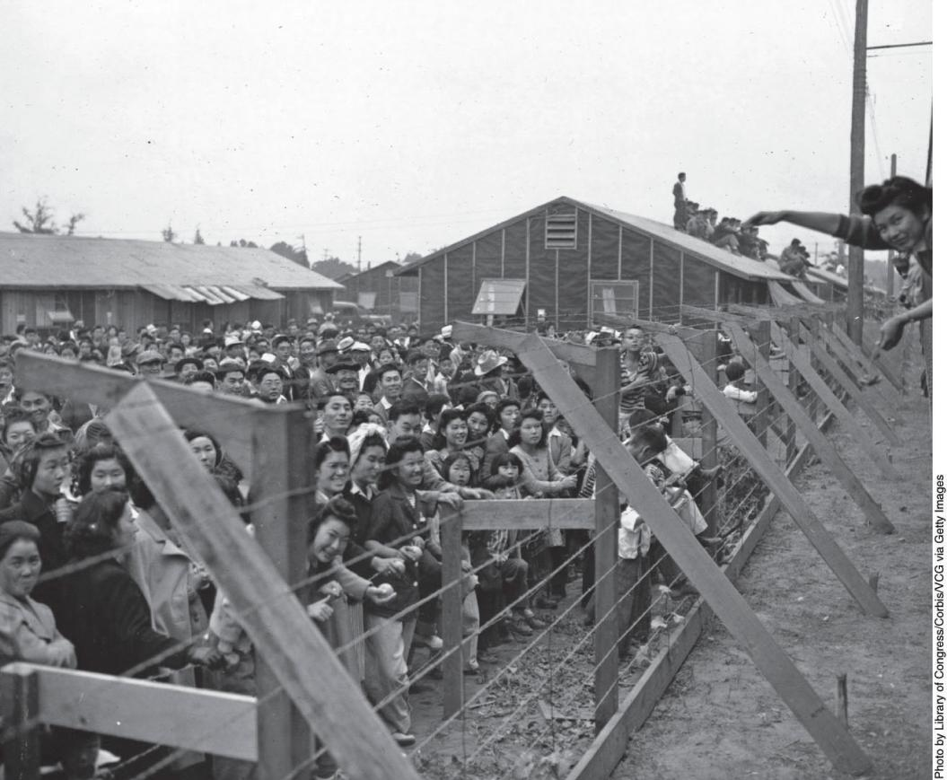
Japanese Americans: World War II
WWII - “Interned” in concentration camps – lost their farms and homes
1944 – US Supreme Court rules internment did not violate Constitution (Korematsu v US)
2018 – Supreme Court expressly overrules the 1944 decision while upholding President Trump’s travel ban: the decision “was gravely wrong the day it was decided” – Chief Justice John Roberts
Notes:
During World War II, tens of thousands of Japanese Americans were forced to relocate to internment camps. Nearly two-thirds were American citizens, and most lost their homes and jobs.

